Slide 1
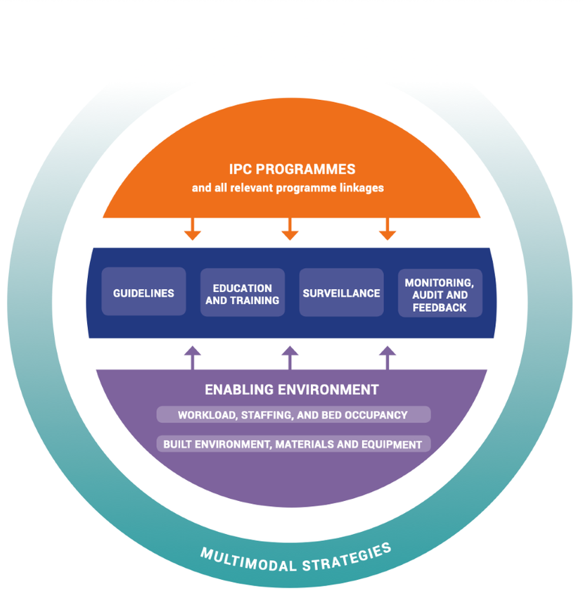
WHO Guidelines on core components of IPC programmes
8 Core components
IPC programme
IPC guidelines
IPC education and training
HAI surveillance
Multimodal strategies
Monitoring/audit of IPC practices and feedback
Workload staffing and bed occupancy
Built environment, materials and equipment for IPC
Ref: Guidelines on Core Components of Infection Prevention and Control Programmes at the National and Acute Health Care Facility Level. Geneva: World Health Organization; 2016.

Slide 2
Five-step cycle to IPC improvement
https://www.who.int/publications/i/item/9789241516945

Slide 3
Ensure all pre-requisites are in place for a successful intervention/program
  Key players and their roles and responsibilities (e.g., who will do HHC auditing)
  Resources required (e.g., do auditors need dedicated time)
  Infrastructure (e.g., ABHR brackets to be installed?)
  Planning and coordination of activities
Can be refined during Step 3 after conducting Step 2

Slide 4
Conduct a baseline assessment of the current situation
  HHC baseline data collection on target ward(s)
  HH product availability

Slide 5
Develop a tailor-made action plan (e.g., HH program launch, education plan)
Needs to address local realities (e.g., access to ABHR)
Prioritize areas for improvement
  May need a step-wise approach to overall improvement (e.g., target higher-risk clinical areas first)
Refine initial plans (Step 1) following baseline assessment (Step 2)

Slide 6
Assess your interventions (e.g., HHC audit again)
Use the same tools used for the baseline assessment (Step 2) so that you can accurately compare before and after

Slide 7
Continue to review and assess your program/intervention
  e.g., regular HHC monitoring, reporting and feedback
May refine ongoing action plan or step-wise improvement plan
  e.g., HHC results show sustained improvement by one group of HCWs but not another – may need to focus education on the latter group for a time

