Slide 1

Hand Hygiene in Oral Health/Dental Setting
Adapted from the 'My 5 moments for hand hygiene', URL: http://www.who.int/gpsc/5may/background/5moments/en/index.html © World Health Organization 2009. All rights reserved.

Slide 2
Learning Package Objectives
Introduce the potential for organism transfer related to hand hygiene practices in the oral health setting
Identify when hand hygiene should be performed in the Oral Health setting
Identify important considerations for hand hygiene and glove use in the Oral Health setting

Slide 3
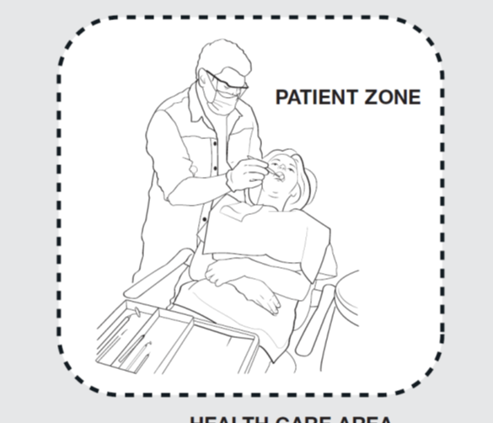
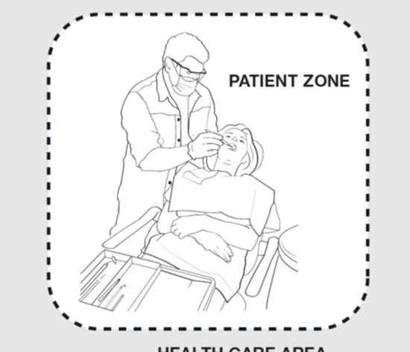
The Zones
In the oral health setting there are two zones:
The CONTAMINATED zone and the CLEAN zone –
The CONTAMINATED zone (or patient zone) is the area directly around the patient that may become contaminated by the treatment once in progress, this includes the patient themselves.
The CLEAN zone (or healthcare zone) is the area outside of the contaminated area and should not become contaminated with patient blood or saliva

Slide 4
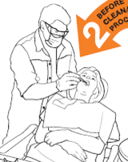
The Contaminated Zone
The CONTAMINATED zone contains:
The patient
The dental chair
Any surface or item touched during a procedure/treatment
Any other surface or item that may be deemed contaminated by the treatment in progress

Slide 5
The Contaminated Zone
Although in the Oral Health setting a patient may only be in this zone for a short period of time their organisms will still contaminate the area.
In addition, this zone may become contaminated with the patient’s saliva and blood from spread of droplets, splash and splatter during procedures.
Aerosols may also be generated during the use of high speed hand pieces. These then fall, covering and contaminating hard surfaces within this zone.
All items and surfaces within the contaminated zone must be decontaminated, cleaned, sterilised or disposed of between each patient.

Slide 6
The Clean Zone
The Clean Zone is the area OUTSIDE of the contaminated zone.
It includes –
The desk/work station/computer area
Patient chart/records
All surfaces and drawers where clean or sterilised instruments are stored and never come in contact with contaminated instruments or equipment.
The Clean Zone is NOT part of the Contaminated Zone, staff should not move between the patient and the Clean Zone without performing hand hygiene.

Slide 7
The Clean Zone
Although the clean zone should NOT be contaminated during any treatments, the clean zone WILL contain organisms that are foreign to the patient.
These organisms can potentially be harmful to the patient if transferred from the CLEAN ZONE to the patient via hands.
This transmission can result in infection, particularly during treatments/procedures.
Oral health/dental staff should not move from the Clean Zone to touching the patient without cleaning hands.

Slide 8
Principles behind hand hygiene
Patients being treated in the oral health setting are at risk of a healthcare-associated infections if organisms are transferred between patients, staff and/or the environment.
The environment in the oral health/dental facility contains a wide variety of different organisms that can be transferred to patients or staff.
Although the patient’s mouth is not a sterile site, foreign microorganisms should not be introduced.

Slide 9
Hand hygiene in the Oral Health Setting
Performing hand hygiene at the correct times will prevent -
Transfer of organisms to the patient (usually from another patient or from the CLEAN zone)
Introduction of foreign organisms during dental/oral health treatments
Transfer of organisms to staff (during OR after treatments)
Contamination of the Clean zone and extended environment

Slide 10
Defining the Moments for Hand Hygiene in the Oral Health setting

Slide 11
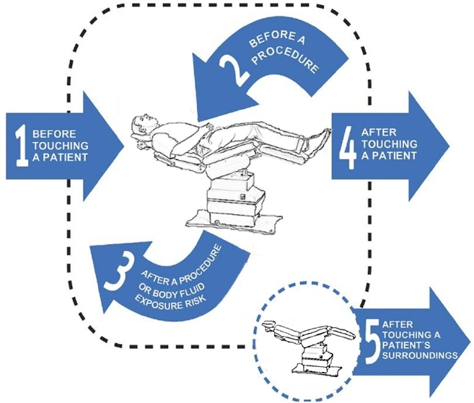
Moment 1 – Before Touching a Patient
In the oral health setting hand hygiene should be performed –
Before entering the CONTAMINATED zone and touching the patient.
This will protect the patient from the potential transfer of organisms (usually from another patient or from the CLEAN zone)

Slide 12
Patient
Refers to any part of the patient, their clothes, or any medical device that is connected to the patient.

Slide 13
Key Principle for Oral Health
Hand hygiene should be performed on entering the CONTAMINATED zone, BEFORE touching the patient.
NOTE: if gloves are required, hand hygiene must still be performed prior to donning gloves.

Slide 14
Moment 1
When: | Examples:
After entering the contaminated zone and before touching the patient in the dental chair | Before: Shaking hands (with a patient already in the dental chair), assisting patient into chair, assisting patient with safety glasses and bib, placing relative analgesia mask on patient, handing the patient a glass of water, touching any medical device connected to the patient, placing X-ray cone against patient’s cheek, handing the consent form to the patient to sign, taking a patient’s blood pressure, positioning the patient for X-ray or OPG. Any non-invasive treatment such as assisting a patient to brush their teeth (may be a Moment 2 if mucous membranes not intact) or rinse their mouth, taking a patient’s blood pressure, examination of a patient’s mouth without using a sharp instrument e.g. only using a mirror.

Slide 15
Example
Dental Assistant enters contaminated zone, positions patient in dental chair, assists the patient to apply their bib and safety glasses.
Hand hygiene should be performed on ENTERING the contaminated zone BEFORE touching the patient.

Slide 16
Moment 2 – Before A Procedure
In the oral health setting hand hygiene should be performed –
IMMEDIATELY before donning gloves and starting a procedure/treatment
This will protect the patient from the potential introduction of foreign organisms during the procedure/treatment.

Slide 17
Key Principle for Oral Health
Hand hygiene is to be performed before all glove use. Always perform hand hygiene immediately prior to donning gloves.
NOTE: Once hand hygiene has been performed and gloves applied, only equipment required for that procedure should be touched.

Slide 18
Moment 2
When: | Examples:
The use of an instrument in a patient’s mouth where there is the likelihood of penetration of tissue or cavity; or contact with non-intact mucosa or non intact skin. | All dental procedures including –Invasive examinations, restoration/s, extractions
Preparation and administration of any medications or materials for any oral health/dental procedure | Administering topical medication such as fluoride, topical anaesthetic, local anaesthetic or tooth mousse or Restorative materials used for restoration procedure.
Administration of medications where there is direct contact with non-intact mucous membrane

Slide 19
Example
Dentist performs a tooth extraction.
Hand hygiene should be performed IMMEDIATELY prior to donning gloves and starting the extraction.

Slide 20
Moment 3 - After A Procedure or Body Fluid Exposure Risk
In the oral health setting hand hygiene should be performed
IMMEDIATELY after removing gloves on completion of a procedure/treatment or after cleaning of contaminated area.
This will protect the patient, the staff and the clean zone from the potential contamination of micro-organisms

Slide 21
Body Fluid Exposure Risk
Any situation where contact with body fluids may occur.
Includes contact with items/surfaces within the Contaminated Zone.

Slide 22
Actual or potential contact with:
Body fluids (including, but not limited to) -
Blood
Saliva
Tears
Mucous and pus
Vomitus
Urine, faeces
Extracted teeth
Tissue samples, including biopsy specimens, cell samples

Slide 23
Key Principle for Oral Health
Hand hygiene is to be performed after all glove use. Always perform hand hygiene IMMEDIATELY on removing gloves.
NOTE: If the staff member is required to move out of the contaminated zone (particularly to the clean zone) during a procedure they are required to remove gloves and perform hand hygiene.
Hand hygiene will be required again prior to donning new gloves if returning to the procedure.

Slide 24
Moment 3
When: | Examples:
After any Moment 2 | See Moment 2
After any potential body fluid exposure | Contact with a used instruments and dental appliances, Contact with saliva either directly or indirectly via a cup or tissue, Contact with used specimen jars / pathology samples, Cleaning dentures, Cleaning spills of body fluid from patient surroundings, After touching the outside of suction tubing, After touching surfaces previously handled by contaminated gloves (e.g. the chair side overhead light or X-ray tube), after decontamination of the contaminated zone, including over head light, dental assistant cart, operators cart, dental chair and dental assistants chair.

Slide 25
Example
Dentist performs a tooth extraction.
Hand hygiene should be performed IMMEDIATELY prior to donning gloves and starting the extraction.
Hand hygiene should be performed IMMEDIATELY after removing gloves at the end of the extraction.

Slide 26
Example
Dental assistant removes instruments from the CONTAMINATED zone and moves them to the collection area.
Hand hygiene should be performed IMMEDIATELY after removing gloves after moving the contaminated instruments.

Slide 27
Moment 4 – After Touching A Patient
In the oral health setting hand hygiene should be performed –
- On leaving the CONTAMINATED zone after touching the patient.
This will protect the staff and the clean zone from potential contamination with patient organisms.

Slide 28
Key Principle for Oral Health
Hand hygiene should be performed on exiting the CONTAMINATED zone, AFTER touching the patient.
NOTE: if gloves were worn, hand hygiene must still be performed on removal of gloves.

Slide 29
Example
Dental assistant walks in, positions the patient in the dental chair, assists the patient to apply safety glasses and bib, then moves to the clean zone.
Hand hygiene should be performed on leaving the CONTAMINATED zone BEFORE moving to the CLEAN zone.

Slide 30
Moment 5 – After Touching Surroundings
In the oral health setting hand hygiene should be performed
On leaving the CONTAMINATED zone if any items have been touched.
This will protect the staff and the clean zone from potential contamination with patient organisms.

Slide 31
Immediate Patient Surroundings
  A space temporarily dedicated to an individual patient for that patient’s visit-
  In the oral health setting this includes:
    Dental chair and equipment
    Patient’s personal belongings
    Anything touched by HCW (other than items used during a procedure/treatment) while caring for that patient

Slide 32
Key Principle for Oral Health
Hand hygiene should be performed on exiting the CONTAMINATED zone, AFTER touching the surroundings.
NOTE:
- If gloves were worn, hand hygiene must still be performed on removal of gloves.
- If there has been contact with the patient’s blood or saliva this will be a Moment 3.

Slide 33
Moment 5
When: | Examples:
After touching the patient’s immediate surroundings when the patient has not been touched. On exit of zone if you have been in contact with the patient’s belongings. | Patient surroundings include: Chair, Equipment, Control panel for chair & x-ray, Light switches, Personal belongings.

Slide 34
Example
Dental assistant walks in, adjusts the patient position by touching the control panel and then moves out of the contaminated zone.
Hand hygiene should be performed on leaving the CONTAMINATED zone.

Slide 35
Glove Use
Gloves are not a substitute for hand hygiene
Hand hygiene should be performed before & after all glove use
Always perform hand hygiene immediately prior to donning gloves
Always perform hand hygiene immediately after removing gloves
Gloves are a single use item: they are to be used once and disposed off, not disinfected or washed

Slide 36
Key Message for Hand Hygiene in Oral Health
Perform hand hygiene on entering the Contaminated Zone (patient zone)
Perform hand hygiene on leaving the Contaminated Zone (patient zone)
If moving between the Contaminated and Clean Zones, hand hygiene is ALWAYS required
Perform hand hygiene immediately prior to donning gloves
Perform hand hygiene immediately after removing gloves
If you always follow these principles you will always be protecting the PATIENT, YOURSELF, other STAFF and the CLEAN ZONE.

Slide 37
The 5 Moments

