Slide 1

5 Moments for Hand Hygiene
Based on the 'My 5 moments for Hand Hygiene', URL: http://www.who.int/gpsc/5may/background/5moments/en/index.html © World Health Organization 2009. All rights reserved.

Slide 2
Session Objectives
Introduce the concept of micro-organism transmission
Identify the 5 Moments
Define the 5 Moments for Hand Hygiene and related terminology

Slide 3
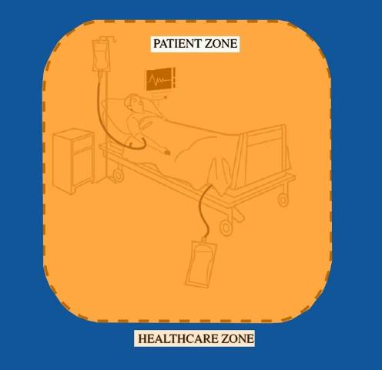
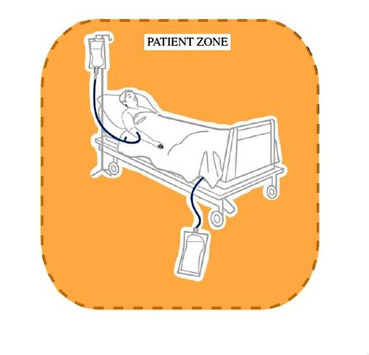
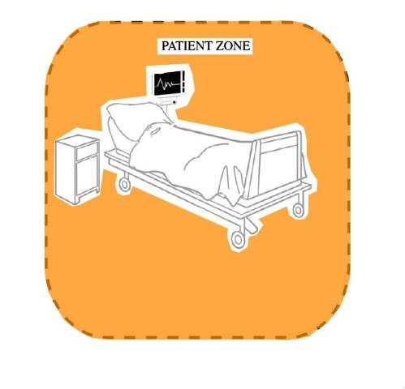
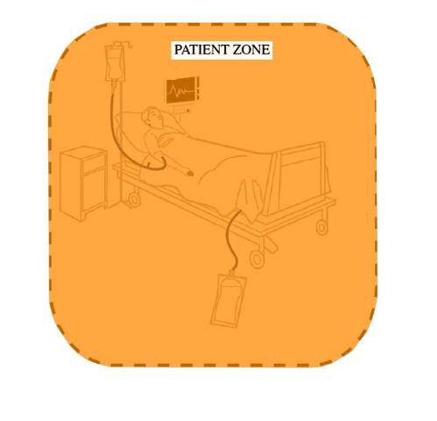
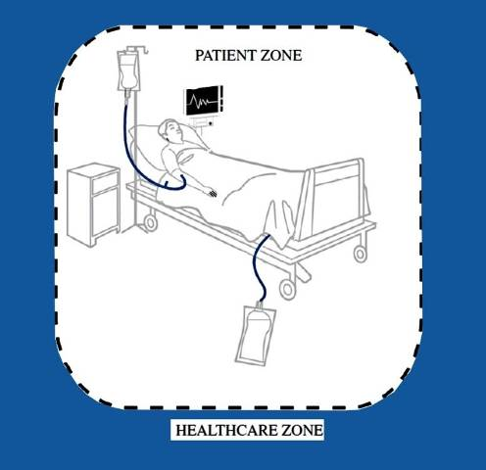
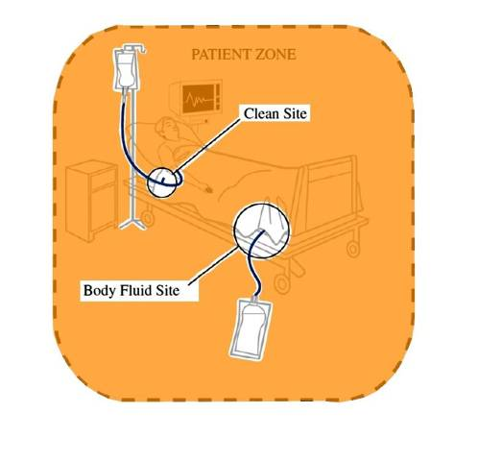
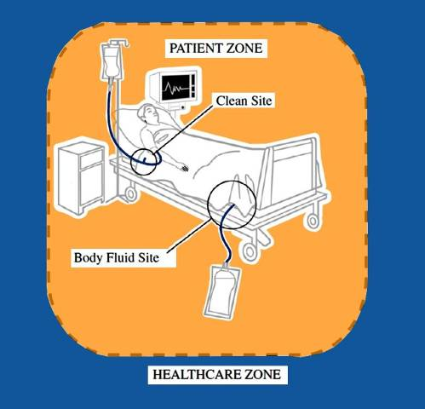

Two Zones
The Healthcare Zone
The Patient Zone:
  The patient &
  The patient’s
  immediate
  surroundings
Notes:
Patient Zone (orange area) includes the patient & the patient’s immediate surroundings within that zone there are 2 critical sites

Slide 4
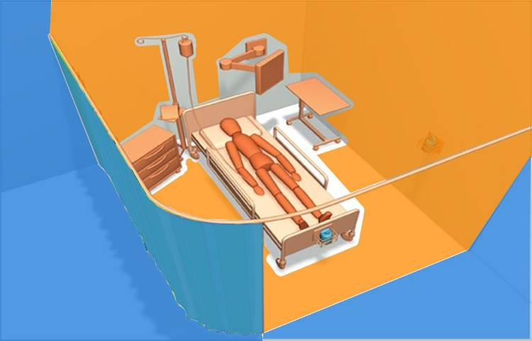
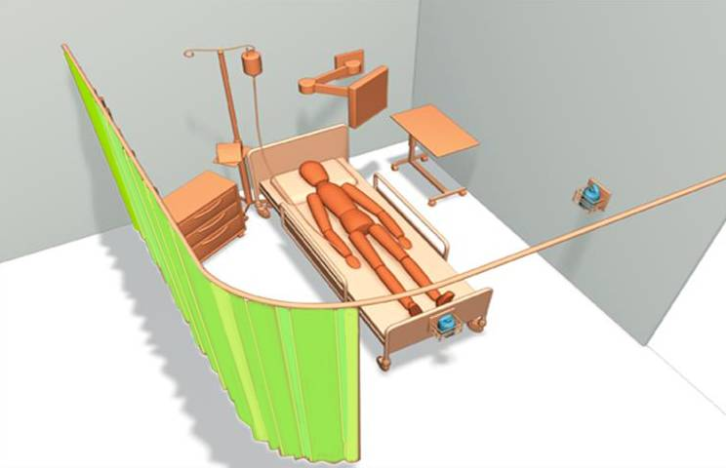
Patient Zone
From Ontario Just Clean Your Hands Program
The science behind Just clean your hands presentation

Slide 5
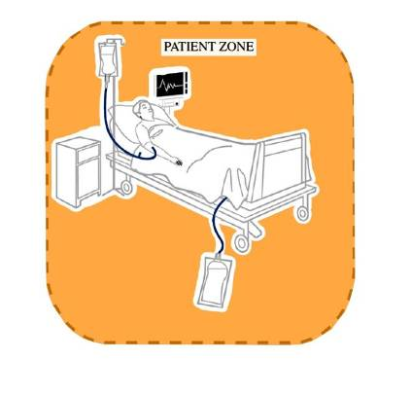
Patient Zone
Assumptions
  Patient flora rapidly contaminates entire patient zone
  Patient zone is cleaned between patients
Notes:
Assumptions are generally made that within the pt zone
Patient flora rapidly contaminates entire patient zone
Patient zone is cleaned between patients

Slide 6

Healthcare Zone
Assumptions
  Contaminated with organisms foreign and potentially harmful to Patient X
  Transmission results in colonisation / infection
Notes:
Assumptions are generally made that within the healthcare zone
That contaminated with organisms foreign and potentially harmful to Patient X occur
Transmission results in exogenous infection

Slide 7
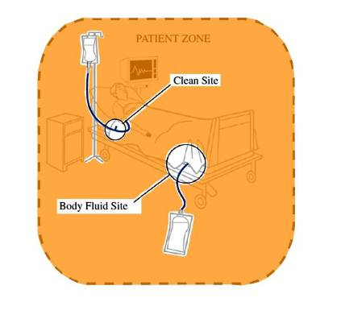
Critical sites
Clean sites
  Have to be protected against microorganisms
Body fluid sites
  Lead to hand exposure of body fluids
Notes:
Anywhere we there is portal for entry of micoorganisms we need to be conscious of and protect

Slide 8
Sources of Transmission
Patients are the main source of healthcare microorganisms
The healthcare zone is a secondary source as it contains a wide variety of healthcare
microorganisms
The patient zone becomes colonised by the patient’s own microorganisms

Slide 9
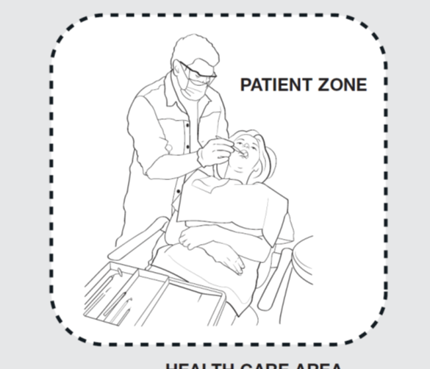
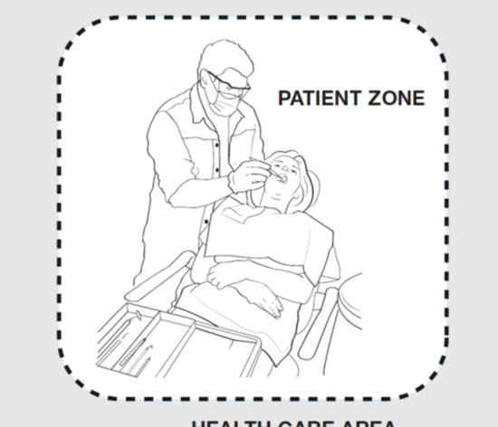
The Zones
In the oral health setting there are two zones:
The CONTAMINATED zone and the CLEAN zone –
The CONTAMINATED zone (or patient zone) is the area directly around the patient that may become contaminated by the treatment once in progress, this includes the patient themselves.
The CLEAN zone (or healthcare zone) is the area outside of the contaminated area and should not become contaminated with patient blood or saliva

Slide 10
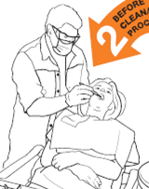
The Contaminated Zone
The CONTAMINATED zone contains:
The patient
The dental chair
Any surface or item touched during a procedure/treatment
Any other surface or item that may be deemed contaminated by the treatment in progress

Slide 11
Performing Hand Hygiene Prevents:
Cross colonisation of patients
Infection in patients
Infection in HCWs
Cross colonisation of the healthcare environment

Slide 12
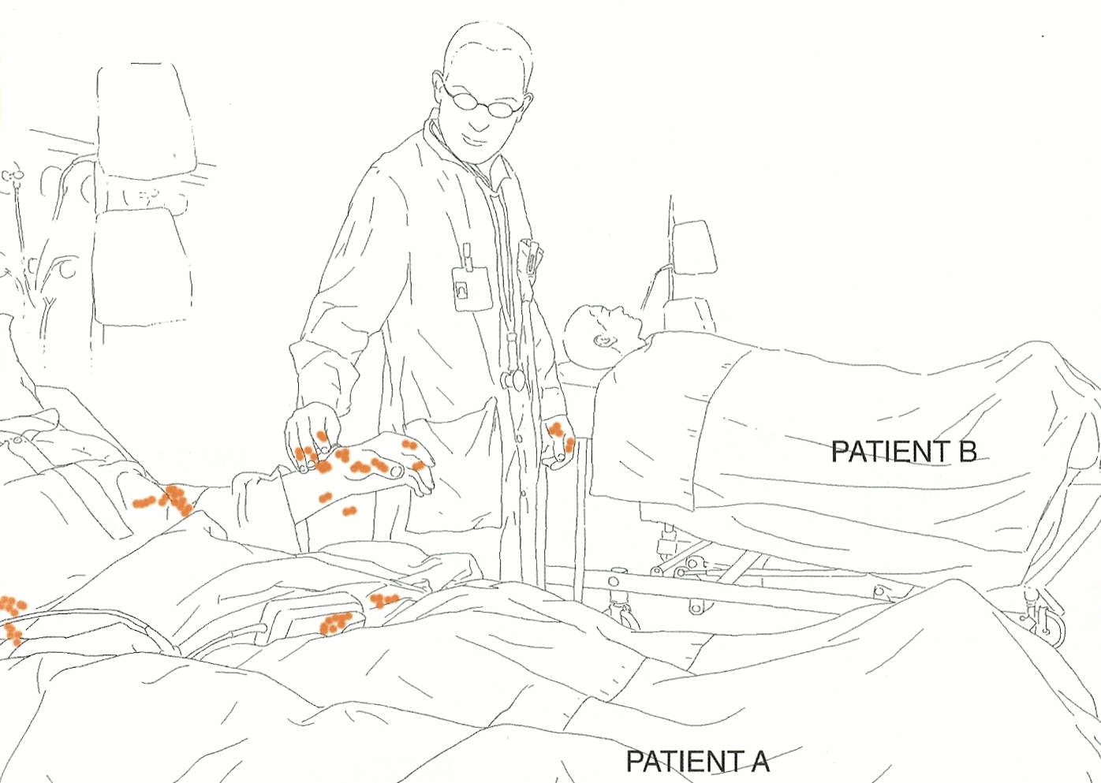
Possible cross contamination between Patient A and Patient B

Slide 13
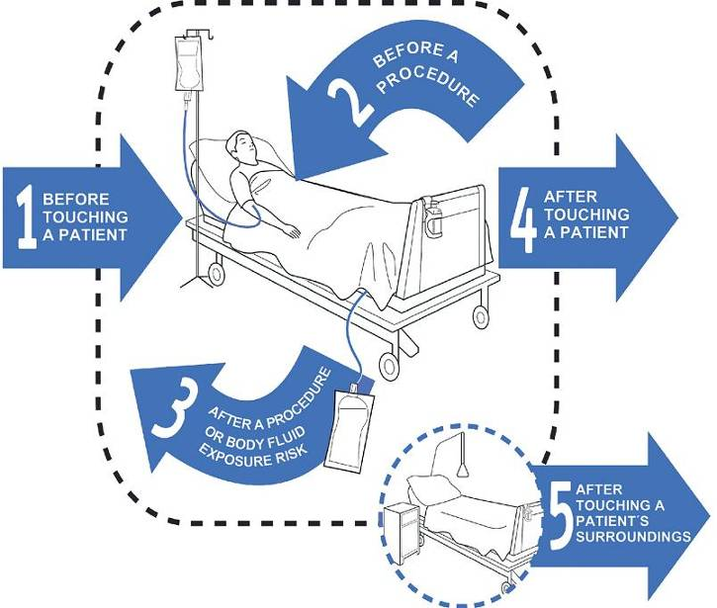
The 5 Moments

Slide 14
5 Moments for Hand Hygiene
Theoretical model for prevention of transmission of microorganisms
  Split into 5 key “moments” where hand hygiene should be performed
  Grouped as:
    BEFORE moments – perform hand hygiene to prevent colonisation/infection in PATIENTS
    AFTER moments - perform hand hygiene to prevent colonisation/infection in HEALTHCARE STAFF

Slide 15
5 Moments Program
Culture change program NOT just auditing
Aim: to prevent infections
Everyone agrees:
  Patient safety is paramount
  Hand hygiene is imperative for patient safety

Slide 16
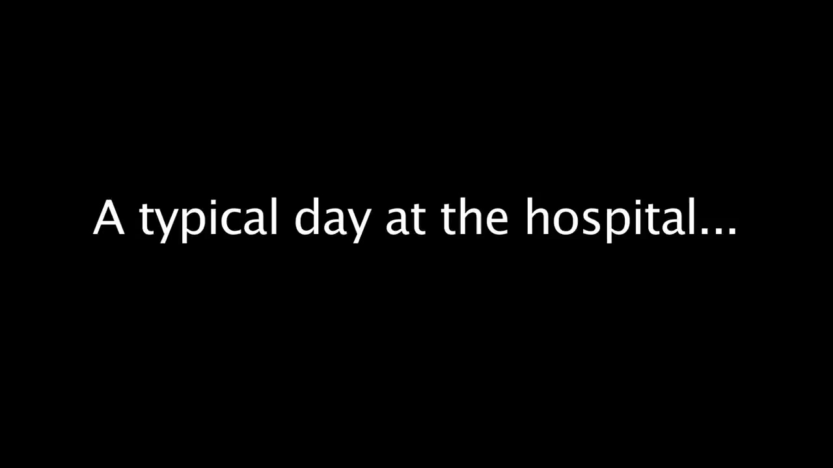
Play Video
*Add link to a typical day video

Slide 17
5 Moments Definitions

Slide 18
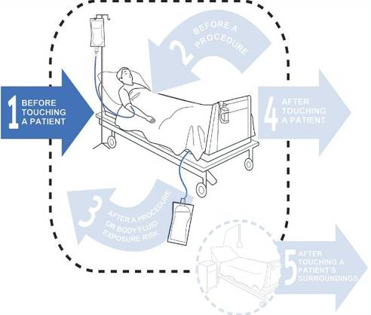
Moment 1 – Before Touching a Patient
Performing hand hygiene prevents
patient colonisation with healthcare microorganisms

Slide 19
Patient
Refers to any part of the patient, their clothes, or any medical device that is connected to the patient
If the patient were to get out of bed and walk off – what would still be attached to them?

Slide 20
Moment 1
When: | Examples:
Before touching a patient in any way | Shaking hands, Assisting a patient to move, most Allied health interventions, Touching any medical device connected to the patient (e.g. IV pump, IDC)
Before any personal care activities | Bathing, Dressing, Brushing hair, Putting on personal aids e.g. Glasses
Before any non-invasive observations | Taking a pulse, Blood pressure, Oxygen saturation, Temperature, Chest auscultation, Abdominal palpation, Applying ECG electrodes, CTG
Before any non-invasive treatment | Applying an oxygen mask or nasal cannula, Fitting slings/braces, Application of incontinence aids (including condom drainage)

Slide 21
Moment 1
When: | Examples:
Before preparation and administration of oral medications | Oral medications, Nebulised medications
Before oral care and feeding | Feeding a patient, Brushing teeth or dentures

Slide 22
Moment 1 - Dental
When: | Examples:
After entering the contaminated zone and before touching the patient in the dental chair | Before: Shaking hands (with a patient already in the dental chair), assisting patient into chair, assisting patient with safety glasses and bib, placing relative analgesia mask on patient, handing the patient a glass of water, touching any medical device connected to the patient, placing X-ray cone against patient’s cheek, handing the consent form to the patient to sign, taking a patient’s blood pressure, positioning the patient for X-ray or OPG. Any non-invasive treatment such as assisting a patient to brush their teeth (may be a Moment 2 if mucous membranes not intact) or rinse their mouth, taking a patient’s blood pressure, examination of a patient’s mouth without using a sharp instrument e.g. only using a mirror.

Slide 23
Key Message for Moment 1
Hand Hygiene before touching a patient
  Perform Hand Hygiene on entering the patient’s zone
  Where possible Hand Hygiene should occur in front of the patient so that they can observe it

Slide 24
Example Moment 1
HCW walks in ,helps patient to sit up, moves over bed table, folds down sheets, moves the chair into position, then assists patient out of bed
Moment 1-prior to touching the patient

Slide 25
M1 video
PLAY
*add M1 video here

Slide 26
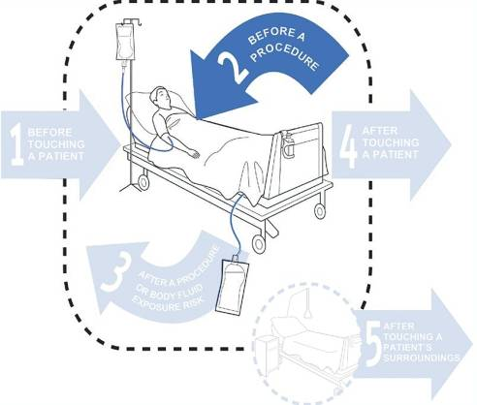
Moment 2 – Before A Procedure
Performing hand hygiene prevents infection in patients
Most healthcare associated infections are due to microorganisms already colonising the patient
Notes:
Endogenous or exogenous

Slide 27
Procedure
Is an act of care for a patient where there is a risk of direct introduction of a pathogen into the patient’s body.

Slide 28
Moment 2
When: | Examples:
Before insertion of a needle into a patient’s skin, or into an invasive medical device | Venipuncture, Blood glucose level, Arterial blood gas, Subcutaneous or Intramuscular injections, IV flush
Before preparation and administration of any medications given via an invasive medical device, or preparation of a sterile field | IV medication, NGT feeds, PEG feeds, Baby tube feeds, Dressing trolley
Before administration of medications where there is direct contact with mucous membranes | Eye drop installation, Suppository insertion, Vaginal pessary

Slide 29
Moment 2
When: | Examples:
Before insertion of, or disruption to, the circuit of an invasive medical device | Procedures involving the following: ETT, Tracheostomy, Nasopharyngeal airways, Suctioning of airways, Urinary catheter, Colostomy/ileostomy, Vascular access systems, Invasive monitoring devices, Wound drains, PEG tube, NGT, Secretion aspiration
Before any assessment, treatment and patient care where contact is made with non-intact skin or mucous membranes | Wound dressings, Burns dressings, Surgical procedures, Digital rectal examination, Invasive obstetric and gynaecological examinations and procedures, Digital assessment of newborns palate

Slide 30
Moment 2 - Dental
When: | Examples:
The use of an instrument in a patient’s mouth where there is the likelihood of penetration of tissue or cavity; or contact with non-intact mucosa or non intact skin. | All dental procedures including –Invasive examinations, restoration/s, extractions
Preparation and administration of any medications or materials for any oral health/dental procedure | Administering topical medication such as fluoride, topical anaesthetic, local anaesthetic or tooth mousse or Restorative materials used for restoration procedure.
Administration of medications where there is direct contact with non-intact mucous membrane

Slide 31
Key Message for Moment 2
Perform Hand Hygiene immediately prior to a procedure
  Once Hand Hygiene has been done, nothing else in the patient’s environment should be touched prior to the procedure starting
Notes:
HCWs generally touch another surface within the patient zone before contact with a clean site

Slide 32
Example: Moment 2
HCW performs subcutaneous injection
Moment 2 – immediately prior to injecting patient

Slide 33
M2 video
PLAY
*add M2 video here

Slide 34
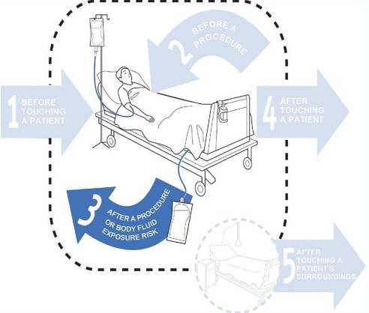
Moment 3
After A Procedure or Body Fluid Exposure Risk
Performing hand hygiene prevents:
Transmission of
microorganisms from a
colonised to clean site
Colonisation/infection in
HCWs
Contamination of the
healthcare zone

Slide 35
Body Fluid Exposure Risk
Any situation where contact with body fluids may occur. Such contact may pose a contamination risk to either the HCW or the environment

Slide 36
Actual or potential contact with:
Blood, Lochia
Saliva or tears
Mucous, wax, or pus
Breast milk, Colostrum
Vomitus
Urine, faeces, semen, or meconium
Pleural fluid, ascitic fluid or CSF
Tissue samples, including biopsy specimens, organs, bone marrow, cell samples

Slide 37
Moment 3
When: | Examples:
After any Moment 2 | See Moment 2
After any potential body fluid exposure | Contact with a used urinary bottle / bedpan, Contact with sputum either directly or indirectly via a cup or tissue, Contact with used specimen jars / pathology samples, Cleaning dentures, Cleaning spills of body fluid from patient surroundings, After touching the outside of a drain

Slide 38
Moment 3 - Dental
When: | Examples:
After any Moment 2 | See Moment 2
After any potential body fluid exposure | Contact with a used instruments and dental appliances, Contact with saliva either directly or indirectly via a cup or tissue, Contact with used specimen jars / pathology samples, Cleaning dentures, Cleaning spills of body fluid from patient surroundings, After touching the outside of suction tubing, After touching surfaces previously handled by contaminated gloves (e.g. the chair side overhead light or X-ray tube), after decontamination of the contaminated zone, including over head light, dental assistant cart, operators cart, dental chair and dental assistants chair.

Slide 39
Key Message for Moment 3
Perform Hand Hygiene immediately after a procedure or a body fluid exposure risk
  As hands are likely to be contaminated with body fluid

Slide 40
Example: Moment 3
HCW performs subcutaneous injection
Moment 2 – immediately prior to injecting patient
Moment 3 – immediately after disposing of sharp

Slide 41
Example: Moment 3
HCW walks into the room, empties IDC drainage bag, disposes of urine in pan room
Moment 2 – Immediately before opening IDC
Moment 3 – Immediately after disposing of urine (exposure risk)

Slide 42
M3 video
PLAY
*add M3 video here

Slide 43
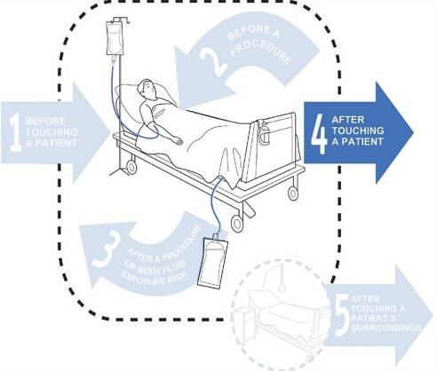
Moment 4 – After Touching A Patient
Performing hand hygiene prevents:
Colonisation/infection
in HCWs
Contamination of the
healthcare zone

Slide 44
Key Message for Moment 4
Hand Hygiene after touching a patient
  This completes the basic message of
  Hand Hygiene before you enter the patient
  room, and before you leave the patient room

Slide 45
Example: Moment 4
HCW walks in, helps the patient to sit up, folds down the sheets, moves the chair into position, then gets the patient out of bed, then leaves the room
Moment 1 – prior to touching patient
Moment 4 – after touching the patient

Slide 46
M4 video
PLAY
*add M4 video here

Slide 47
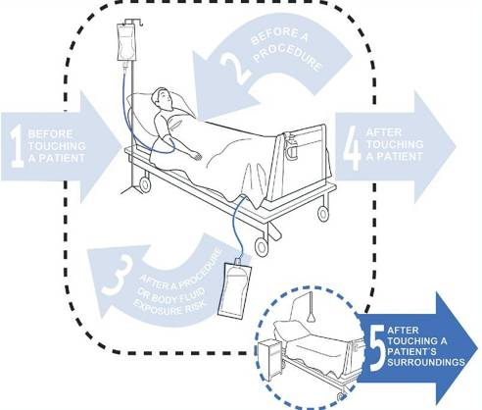
Moment 5 – After Touching A Patient’s Surroundings
Performing hand hygiene prevents:
Colonisation/infection
in HCWs
Contamination of the
healthcare zone

Slide 48
Immediate Patient Surroundings
  A space dedicated to an individual patient for that patient’s stay
  Includes:
    Patient furniture and personal belongings
    Medical equipment – BP machine, monitor
    Medical chart

Slide 49
Moment 5
When: | Examples:
After touching the patient’s immediate surroundings when the patient has not been touched | Patient surroundings include: Bed, Bedrails, Linen, Table, Bedside chart, Bedside locker, Call bell/TV remote control, Light switches, Personal belongings, Chair, Foot stool, Monkey bar

Slide 50
Moment 5 - Dental
When: | Examples:
After touching the patient’s immediate surroundings when the patient has not been touched. On exit of zone if you have been in contact with the patient’s belongings. | Patient surroundings include: Chair, Equipment, Control panel for chair & x-ray, Light switches, Personal belongings.

Slide 51
Key Message for Moment 5
Hand hygiene after touching the patient’s surroundings when the patient has not been touched

Slide 52
Example: Moment 5
HCW walks into patient room, moves the over bed table closer to the patient, then leaves
Moment 5 – after touching the patient surroundings without touching the patient
If patient had been touched, then this would have been recorded as:
Moment 1 and Moment 4

Slide 53
M5 video
PLAY
*add M5 video here

