Slide 1

How to Audit

Slide 2

Session Objectives
Demonstrate recording of
5 moments using the HHA audit tool
Discuss “rules” for Auditing
Discuss glove usage

Slide 3
Rule for Auditing Moment 1
Only record Moment 1 once the HCW touches the patient
Notes:
Rules for each of the moments.

Slide 4
Video Example – Rule for M1
PLAY
*add Rule for M1 video here

Slide 5
Rule for Auditing Moment 2
Moment 2 is immediately prior to any procedure
  Once Hand Hygiene has been performed, nothing else in the patient’s environment can be touched prior to the procedure starting

Slide 6
Video Example – Rule for M2
PLAY
*add Rule for M2 video here

Slide 7
Rule for Auditing Moment 3
Moment 3 is recorded immediately after a procedure or body fluid exposure risk
  Nothing else should be touched prior to performing Hand Hygiene
  Touching the outside of a drain or drainage bag even when the circuit is not broken, is considered a body fluid exposure risk
  Can be recorded as a stand alone moment when there is a body fluid exposure risk but no patient contact

Slide 8
Video Example – Rule for M3
PLAY
*add Rule for M3 video here

Slide 9
Rule for Auditing Moment 4
Moment 4 is recorded after touching the patient
  Touching the patient surroundings after touching the patient is recorded as a single Moment 4
  If after a Moment 3 there is touching of the patient surroundings, before leaving the patient zone this is recorded as a Moment 4

Slide 10
Video Example
Charts after body fluid exposure
PLAY
*add Rule for M4 video here

Slide 11
Rule for Auditing Moment 5
Moment 5 is recorded when the HCW leaves the patient zone after touching the patient’s immediate surroundings and the patient has not been touched
  When multiple items in the patient surroundings are touched, only one Moment 5 is recorded

Slide 12
Video Example
Touching patient surroundings
PLAY
*add Rule for M5 video here

Slide 13
Before / After Moments
Generally for every “before” Moment there should be an “after” Moment recorded
  Moment 1 can either be followed by a Moment 4 or a Moment 3
  Moment 2 is usually followed by Moment 3
  Moment 5 is a stand alone Moment as there is no patient contact
There are a few situations when two “afters” may be recorded sequentially, however you will never have a M1 and M2 in a row

Slide 14
Example:
HCW walks in, picks up drain bottle to view it, puts it down, writes on the medical chart, then leaves
Moment 1 – prior to touching the drain (patient)
Moment 3 – after drain (body fluid exposure risk)
Moment 4 – after chart (continuum of patient care)
Notes:
Explain that these are only examples of moments to get them thinking and not auditing as not action is mentioned

Slide 15
Example:
HCW checks blood glucose level of patient, then leaves
Moment 2 – Immediately prior to pricking finger with lancet
Moment 3 – Immediately after disposing of sample
strip & used lancet, prior to touching
anything else

Slide 16
Action Missed If Not Observed
The HCW must be observed to perform hand hygiene as they approach the patient
If the HCW is seen entering the patient zone and HH is not performed prior to a M1 or M2 then this is recorded as a missed action

Slide 17
Example:
HCW walks in and touches the patient on the shoulder without being observed to perform hand hygiene
Moment 1 – before touching the patient
HH action missed

Slide 18
Only Audit What You Observe
No “before” Moment can be recorded if auditing commences after a HCW is already touching a patient, or in the process of performing a procedure.
No “after” Moment can be recorded unless the Moment is observed.
Notes:
Don’t guess if you didn’t see it don’t record it

Slide 19
Example:
Observation commences whilst HCW is emptying IDC drainage bag. The HCW then leaves the room to dispose of the urine in the pan room
No Moment can be recorded as the start of the procedure and the end of the procedure/body fluid exposure risk have not been observed.

Slide 20
Curtains
Patient bed curtains are outside the patient zone and are frequently contaminated
Touching the curtains is considered to be leaving the patient zone
HH should be performed between touching the curtains and touching the patient and vice versa
Notes:
Curtains are like a door, like you have left the area

Slide 21
Example:
HCW walks into patient room opens the curtains up, then walks out
No Moment - as the curtain is part of the healthcare zone

Slide 22
Example:
HCW walks into a patient room performs hand hygiene, closes the curtains, then touches the patient
Moment 1 - missed

Slide 23
One action = Two moments
Two moments for hand hygiene can occur simultaneously
Example 1
Moving directly from one patient to another without touching anything in between
  This one hand hygiene action is recorded for both the M4 and M1

Slide 24

Example
Pt 1
Pt 2
4
1
Single Moment
Double Moment
1 HH performed
2 moments recorded
Notes:
Click once and the animation will run through, show the moments as the healthcare worker moves around the two patients. The red droplet depicts a bonus moment.

Slide 25
Video Example
One Action Two Moments
PLAY
*add One Action Two Moments 2 pts video here

Slide 26
One action = Two moments
Two moments for hand hygiene can occur simultaneously
Example 2
After touching a patient then performing a procedure on that same patient
  This one hand hygiene action is recorded for both the M4 and M2

Slide 27
Example
Pt 1
Pt 2
2
4
1
2 HHs performed
3 moments recorded
Single Moment
Double Moment
Notes:
Click once and the animation will run through, show the moments as the healthcare worker moves around the two patients. The red droplet depicts a bonus moment.

Slide 28
Video Example
One Action Two Moments
PLAY
*add One Action Two Moments 1 pt video here

Slide 29
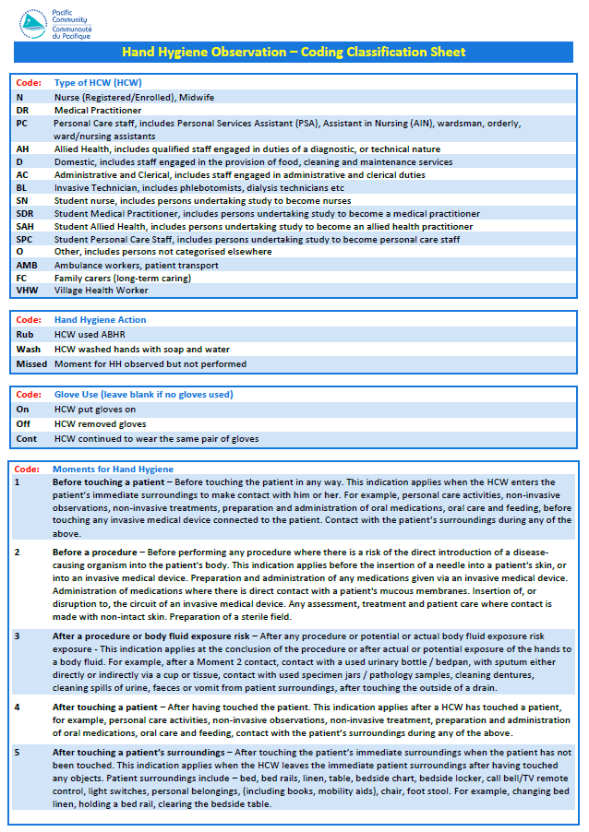
Notes:
When you first begin this sheet will be your favourite piece of paper. It’s a quick guide to all you are observing.Stick inside your folder for ease of use on the wards, Remember you can off course develop your own or we are happy for you to rebadge it

Slide 30
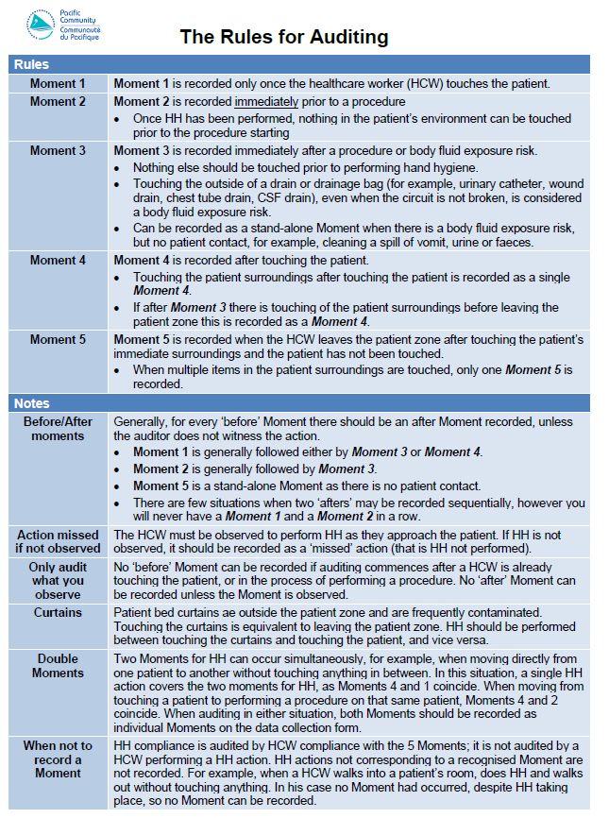

Slide 31
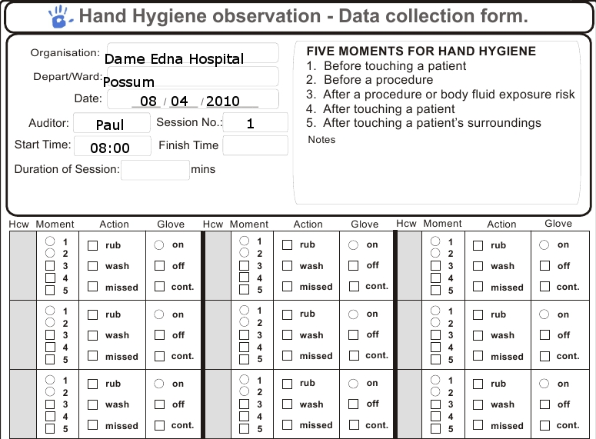
Fill in all demographics at beginning of each session
Notes:
Start a new sheet every time you start, each session

Slide 32
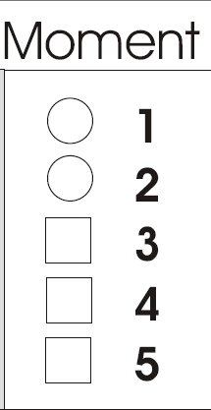
Recording Compliance
It doesn’t matter how you mark your audit sheet but it must be clearly legible for anyone to read

Slide 33

Recording HCW
N
DR
PC
AH
D
AC
BL
SN
SDR
SAH
SPC
O
AMB
FC
VHW
Within HHCApp you can personalise the HCW codes
Eg. Surgeons and anaesthetists can be created under the parent heading DR

Slide 34
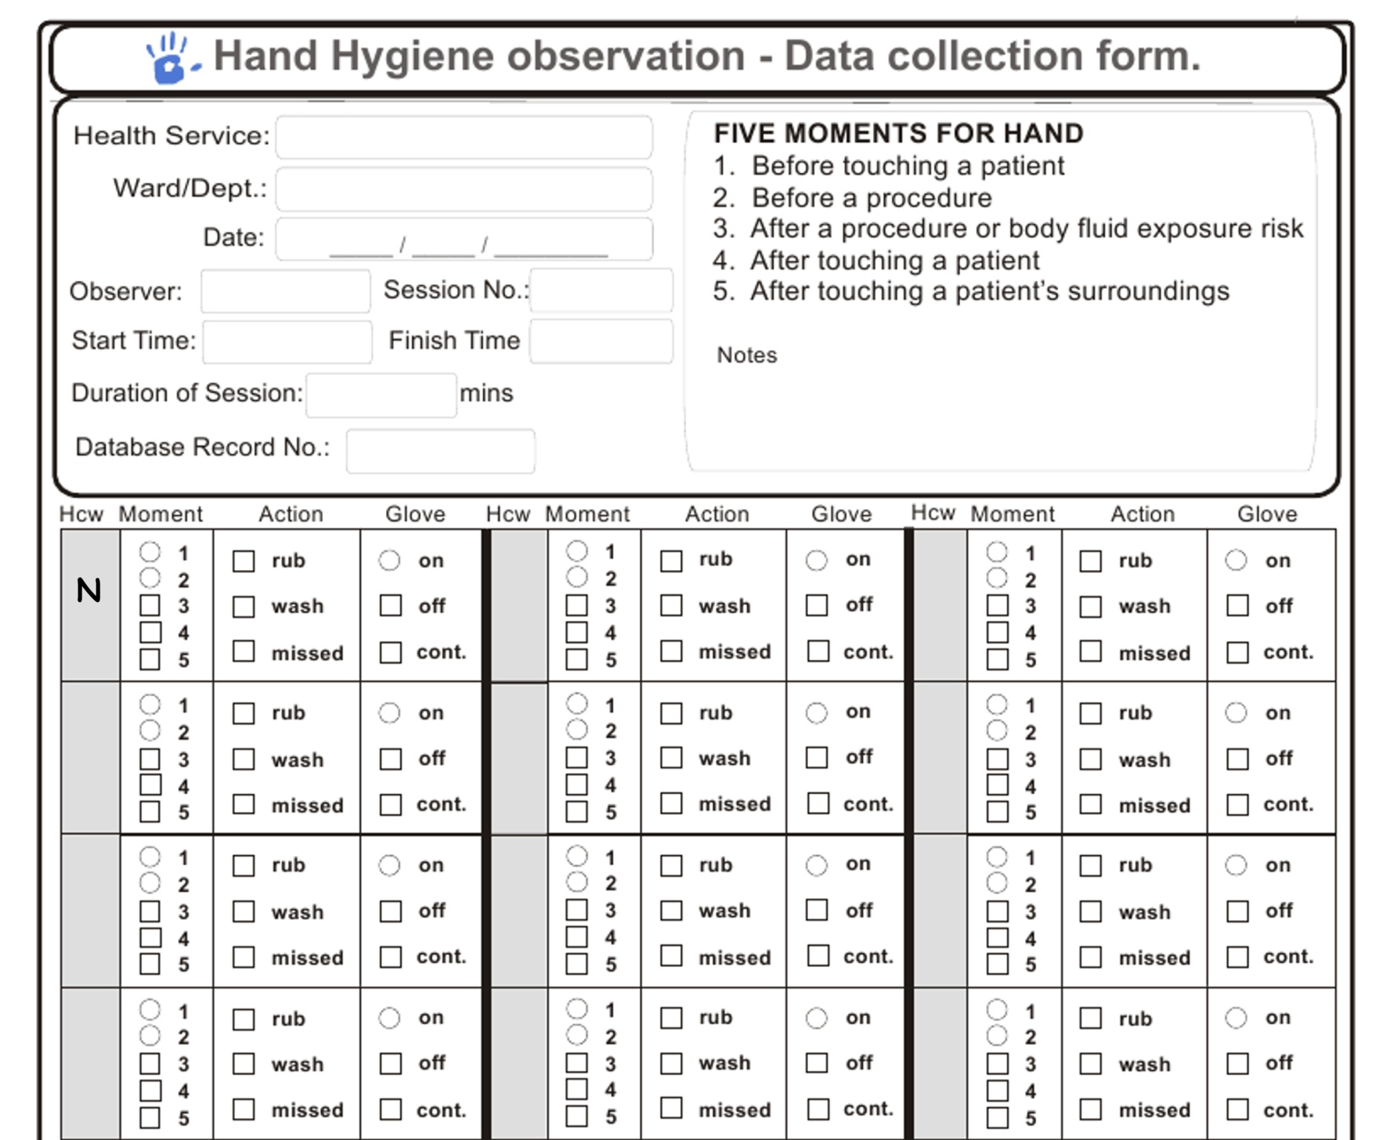

Slide 35
Recording Moments
Before touching a patient
Before a procedure
After a procedure or body fluid exposure risk
After touching a patient
After touching a patient’s surrounding

Slide 36
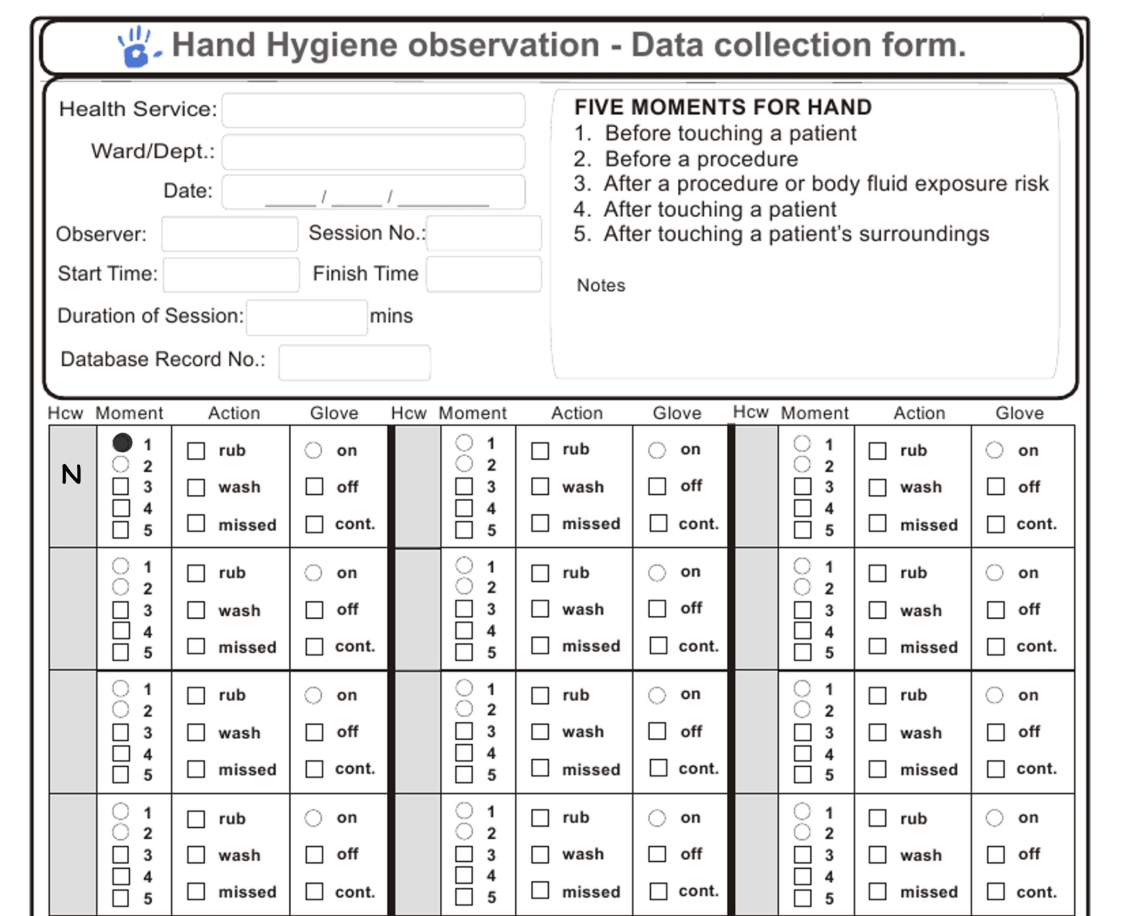

Slide 37
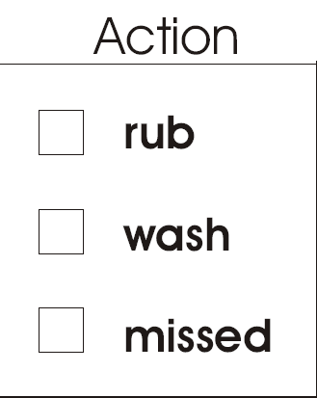
Recording Moments
Used ABHR product
Correct washing with soap and water
No Hand hygiene performed

Slide 38


Slide 39
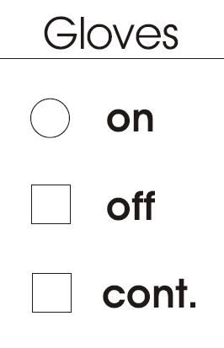
Recording Gloves
Auditor observed HCW put gloves Moment 1 and 2 only
Auditor observe HCW remove gloves Moment 3,4 or 5
Auditor observed HCW continually use same gloves any Moment

Slide 40
Gloves
Gloves are never a substitute for HH
Educate HH before and after all glove use
Never wash or rub gloves
Gloves are only recorded as on in a before Moment (circles with circles)
Gloves are only recorded as off in an after Moment (boxes with boxes)
Gloves can be recorded as continued in any Moment

Slide 41
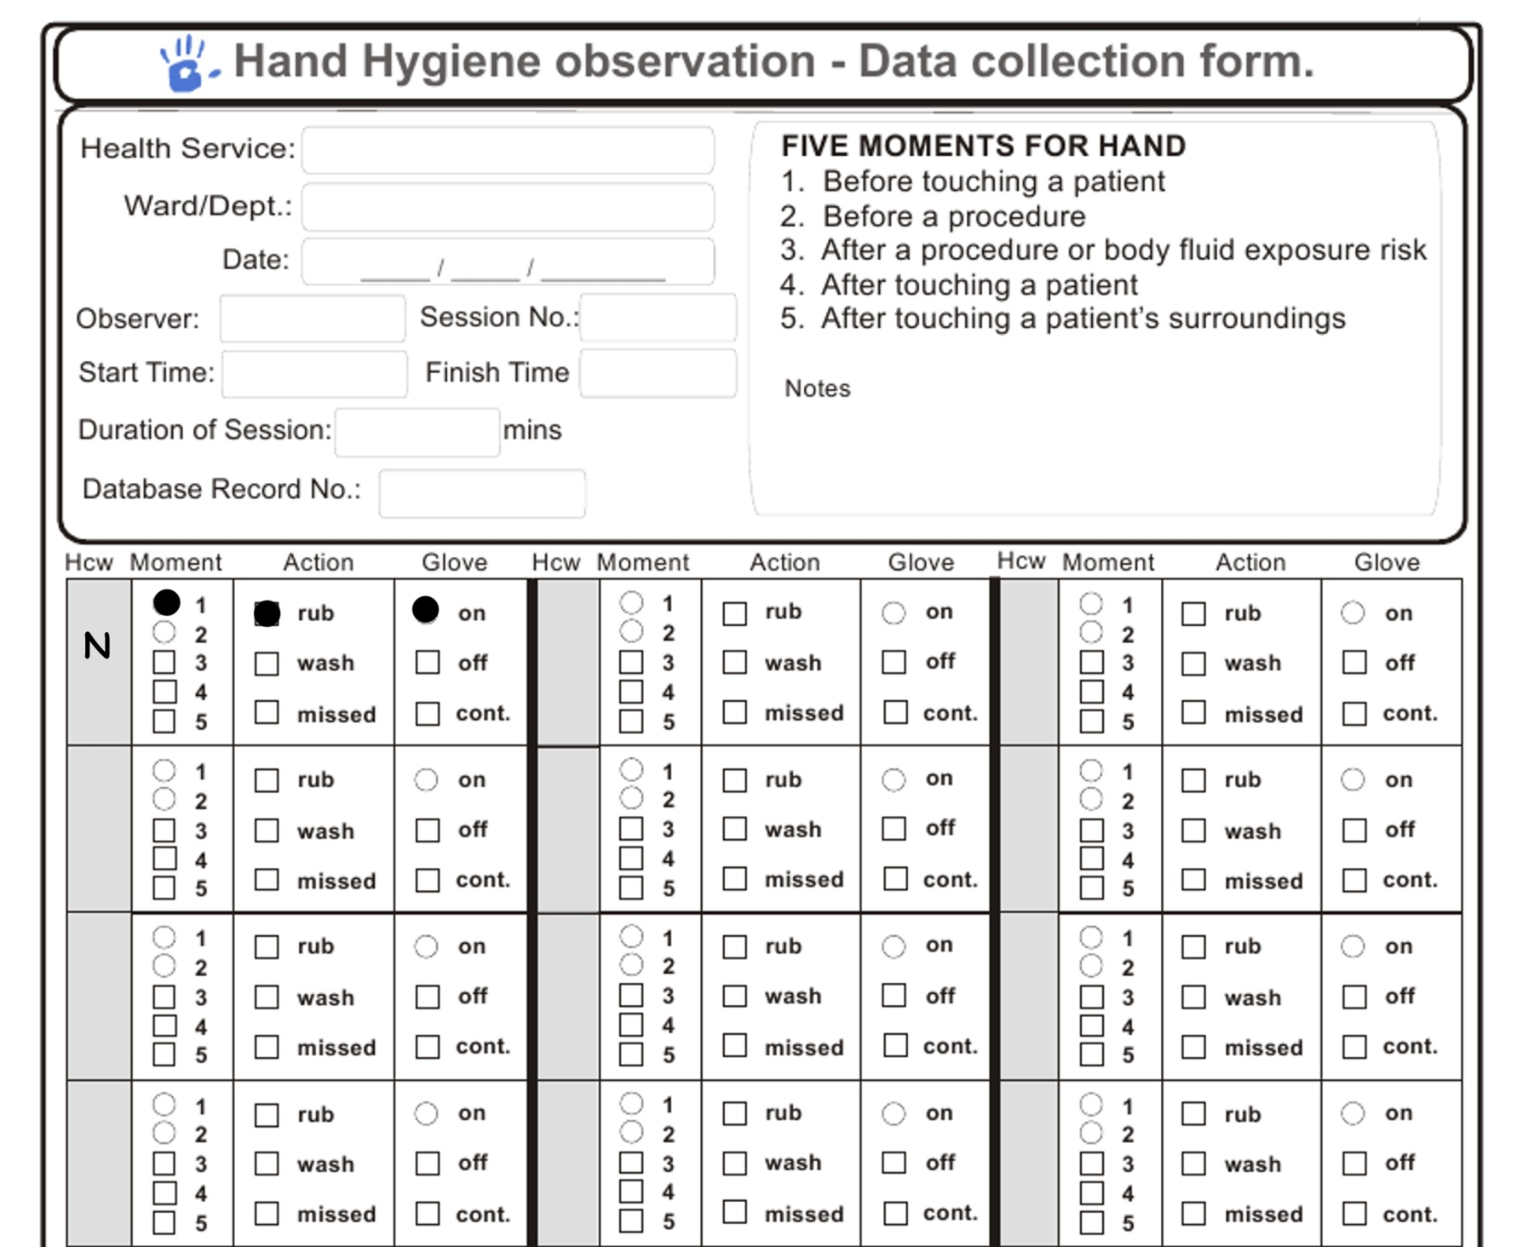

Slide 42
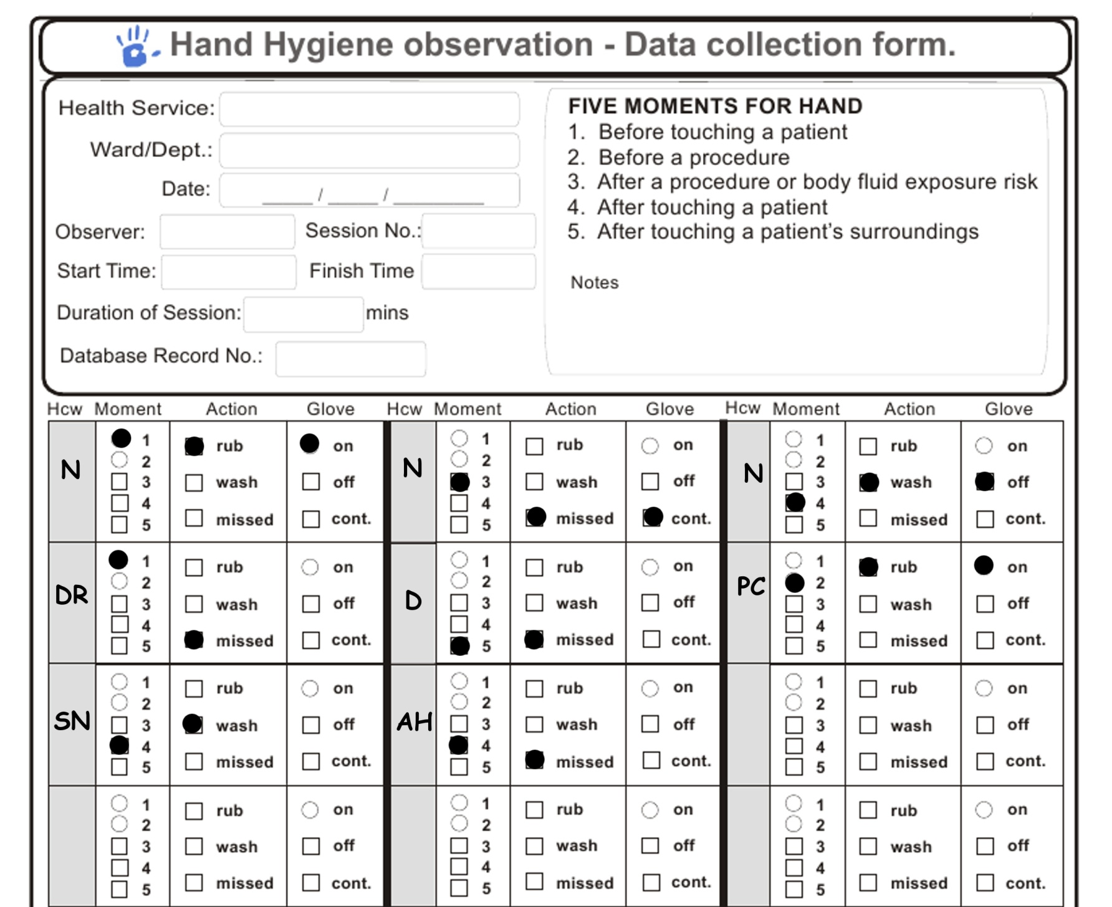

Slide 43
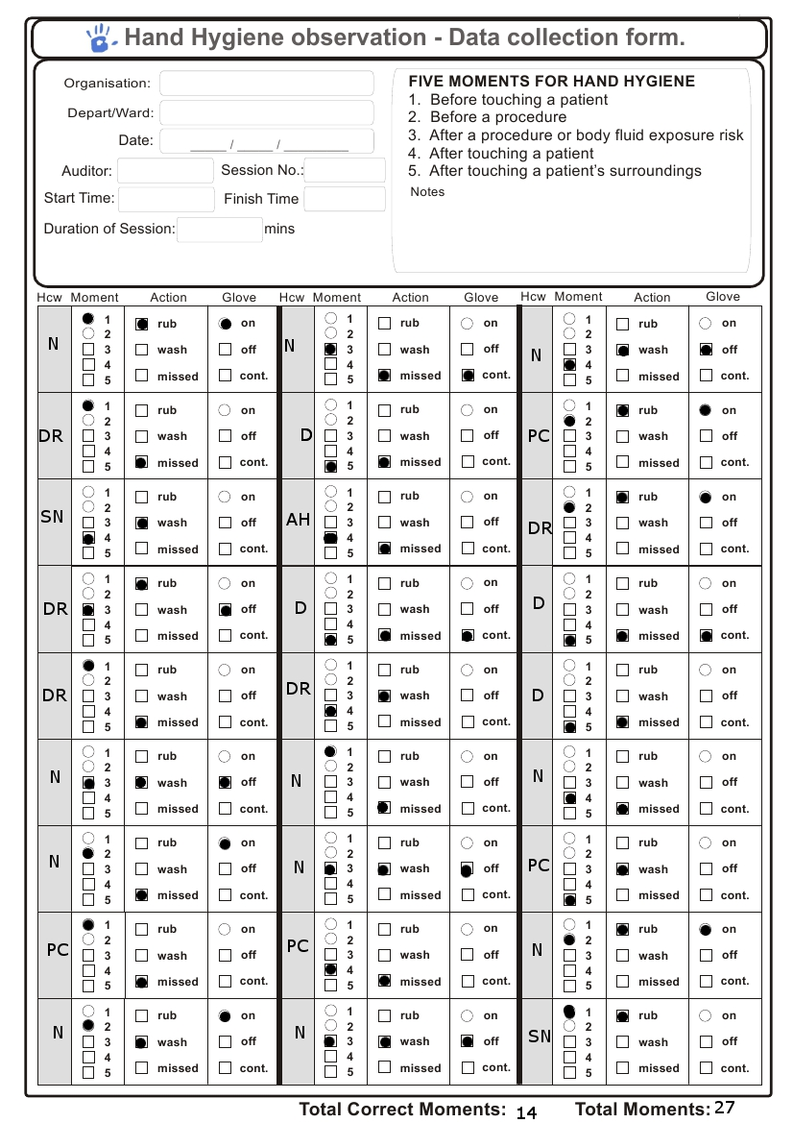
Notes:
When you finish a session your form will look similar to this one. Chances are you wont fill the complete a sheet each time you do a session but it is important that you start a new sheet for each session for you own data entry ease.

Slide 44
Perfecting Data Collection
Fill in demographics on each new sheet each session
One ward per audit sheet per session
Ensure all fields are complete
  HCW, Moment, Action
Only one moment per box
Clearly mark each square

Slide 45
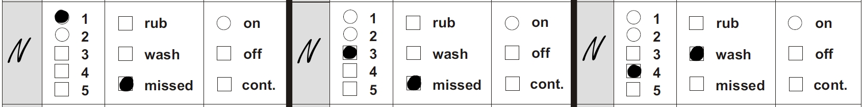
N walks in, picks up drain bottle to view it, puts it down, writes on the medical chart, washes hands, then leaves
More Examples
Moment 1 – prior to touching the drain (patient)
Moment 3 – after drain (body fluid exposure risk)
Moment 4 – after chart (continuum of patient care)
Notes:
45

Slide 46
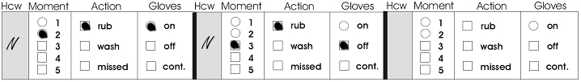
N uses ABHR, puts on gloves, checks blood glucose level of patient, removes gloves, uses ABHR & leaves
More Examples
Moment 2 – Immediately prior to pricking finger with lancet
Moment 3 – Immediately after disposing of sample strip & used lancet, prior to touching anything else
Notes:
46

Slide 47
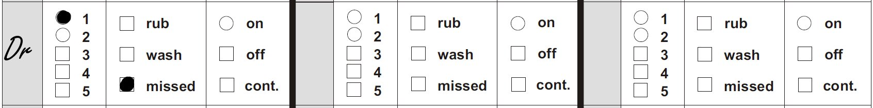
DR walks in and touches the patient on the shoulder without being observed to perform hand hygiene
More Examples
Moment 1 – before touching the patient
HH action missed
*Note: No after moment observed – therefore not recorded
Notes:
47

Slide 48
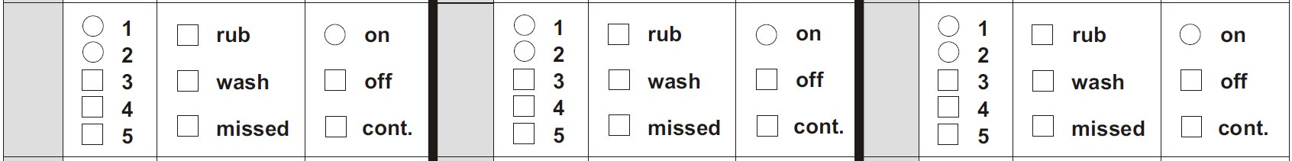
Observation commences whilst N is emptying IDC drainage bag. The N then leaves the room to dispose of the urine in pan room
More Examples
No Moment can be recorded as the start of the procedure and the end of the procedure/body fluid exposure risk have not been observed.
Notes:
48

Slide 49
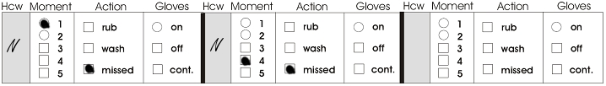
N walks in, silences IV alarm that is connected to the patient, then leaves
More Examples
Moment 1 – prior to touching the “patient”
Moment 4 – after touching the “patient”
Notes:
49

Slide 50
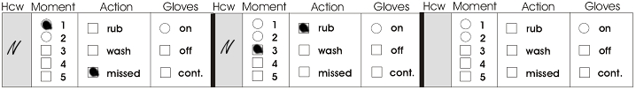
N walks in, picks up IDC to read it, puts it down, uses ABHR, then leaves
More Examples
Moment 1 – pre IDC as IDC is considered to be a part of the patient
Moment 3 – after IDC (potential body fluid risk)
Notes:
50

Slide 51
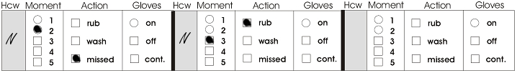
N changes IV fluid bag that is connected to the patient, uses ABHR, then leaves
More Examples
Moment 2 – prior to disconnecting IV
Moment 3 – after reconnecting IV
Notes:
51

Slide 52
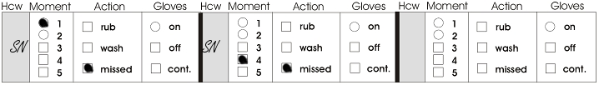
SN prepares oral medications, gives the medications by placing cup in patient’s hand, signs the chart, moves the curtain aside, then uses ABHR
More Examples
1 – pre-giving the medications to the patient
4 – prior to moving the curtain
Notes:
52

Slide 53
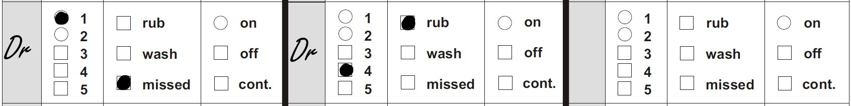
DR walks in, shakes the patient’s hand, uses ABHR, picks up the chart to read it, uses ABHR, then leaves
More Examples
Moment 1 – prior to touching patient
Moment 4 – on leaving (after chart – after continuum of patient care)
*Note: The hand hygiene action in the middle of the scenario was not required at that time & therefore not recorded
Notes:
53
DR should have done HH before touching pt

Slide 54
AH walks into the room opens the patient’s curtains, then leaves the room
More Examples
Nil as the curtains are external to the patient’s surroundings and are not a Moment
Notes:
54

Slide 55
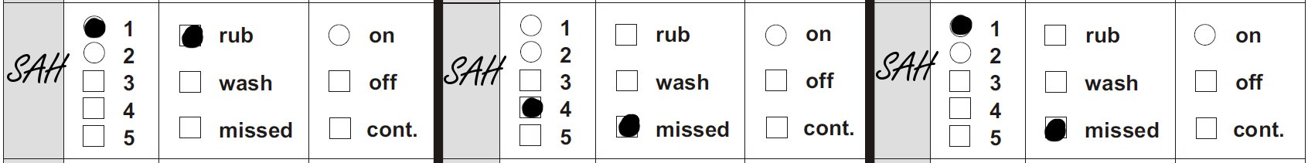
SAH walks into patient room, uses ABHR, helps the patient out of bed, moves the curtain back, then helps the patient to walk out of the room
More Examples
Moment 1 – pre patient
Moment 4 – after patient pre curtain
Moment 1 – after curtain pre patient
*Note: No After Moment is recorded as HCW has not left the patient
Notes:
55

Slide 56
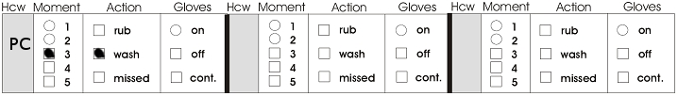
PC walks in, cleans up urine from the floor, washes hands, then leaves
More Examples
Moment 3 – after clean up due to the body fluid exposure risk
*Note: No before Moment is recorded as no patient has been touched
Notes:
56

Slide 57
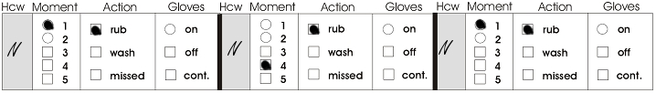
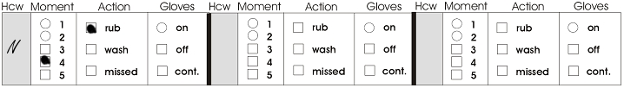
N uses ABHR, assists a patient back to bed, uses ABHR, then assists another patient to stand up, uses ABHR, then leaves
More Examples
Moment 1 – before touching first patient
Moment 4 – after touching first patient
Moment 1 – prior to touching second patient
Moment 4 – after touching second patient
Notes:
57

Slide 58
AH picks up the medication chart and walks out of the room with it
More Examples
Nil as the Moment has not finished
(if you stay in the room to audit other HCWs)
If you follow them out into the healthcare zone
the M5 occurs as soon as they put down the
charts and walk away from them
Notes:
58

Slide 59
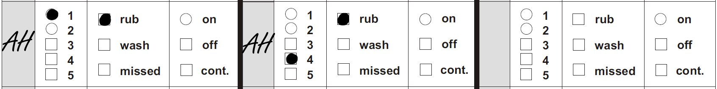
AH walks in, moves the over bed table, uses ABHR, helps the patient out of bed, uses ABHR, then leaves
More Examples
Moment 1 – prior to touching the patient
Moment 4 – after touching the patient
Hand hygiene was done correctly
Notes:
59

Slide 60
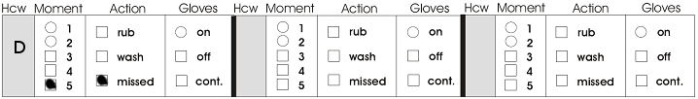
Food services worker (D) walks in with food trolley, moves patient’s belongings off the over bed table, goes back to trolley to get food tray, places tray on patient’s table then walks back to trolley and leaves the room
More Examples
Moment 5 – after touching patient’s surroundings (before getting food tray out of trolley)
*Note: No before moment is recorded as the patient has not been touched
Notes:
60

Slide 61

AH walks in, uses ABHR, moves the overbed table, helps the patient out of bed, uses ABHR, then leaves
More Examples
Moment 1 – prior to touching the patient
Moment 4 – after touching the patient
Hand hygiene was done correctly
Notes:
61

Slide 62
Food services worker (D) walks in with food trolley, places tray on patient’s table then walks back to trolley and leaves the room
More Examples
Nil as Food services worker has not touched the patient’s surroundings
Notes:
62
As long as Food services worker does not touch anything else then there is no moment to record

Slide 63
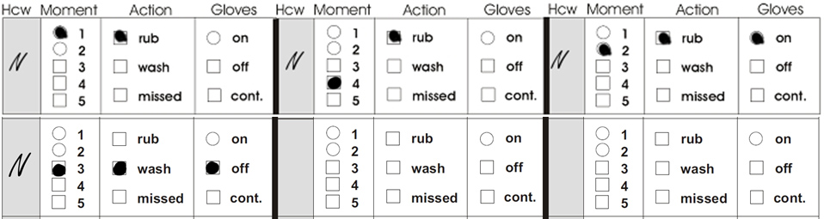
Nurse walks in, uses ABHR, helps the patient to adjust position in bed, uses ABHR, dons gloves, empties IDC, takes urinal to pan room, removes gloves, washes hands, then leaves
More Examples
Notes:
63

