Slide 1
All the pieces fit together…
The Multimodal Method
Auditing
HH Program
Education
&
Interventions
Feedback
Notes:
All of the pieces of the puzzle fit together, as highlighted in the Background talk, modern day Hand Hygiene Programs are multimodal.
All of the pieces are required, eg. No point auditing if the information isn’t fed back & used to develop interventions & no point collecting data if you are not going to do anything with it

Slide 2
Session Objective
Demonstrate the multi modal components of a successful hand hygiene program

Slide 3
All the pieces fit together…
Auditing
HH Program
Education
&
Interventions
Feedback
Notes:
The first piece of the puzzle – draw the line in the sand, this is when our program will start

Slide 4
Implementing a Hand Hygiene Program
All components make up a PROGRAM:
Create a HH team
Conduct a baseline audit
Product selection and placement
Education of staff
Reaudit
Notes:
Its important to get all the main people involved early, include yourself and ideally have your steering committee chaired by a executive member or senior person that way you get support from the top early on, we need to it to happen from the top down
Involve as many areas as possible ,encourage their input let them help you by supporting the program in their area, include allied health, pharmacy, nursing, medical,education depts, engineering all areas.
Area champions is a great way to go as these people will be able to educate their colleagues, apply peer group pressure passively ( of course) and help with product placement according to their work flow and help with specific area marketing
Use people who can help your cause, you cant do this alone. Empower others, encourage others
Remember this is not the HH resources person issue, its not an IC issue but it’s a hospital issue
Having passionate people is a must, meetings & results can quickly turn negative, particularly in the beginning when compliance might be low, passionate & enthusiastic people can keep things progressing

Slide 5
Product Selection
HHA Recommendations:
The Product meets the EN1500 testing standard for bactericidal effect
*Product selection is ultimately the choice of each health care facility, and other factors should also be considered.
**HHA do not promote specific products, nor do they mandate product selection.
Notes:
Select your sentinel wards to begin your auditing on usually 3 is a good number to begin with. Wards are usually selected because of there high rates of infection, often surgical wards but wards that you can make a big impact on..
Once product selection has occurred you need to make sure that is out there to be used by all, on brackets on bed ends ,in corridors ,on trolleys in treatment rooms etc. Work with the NUM of the area as they know their workflow and it keeps them feel involved. There are quite clear recommendations in the manual of where to put it and where we recommend you take caution. There are many issues that may come into play with product selection but whatever you choose its important that your staff are happy to use it.
The education and marketing side of things is an ongoing one and one that needs constantly upgrading, and I know you may find this hard to believe but many HCW find HH a boring topic to many, but regardless of this staff need to know what you expect from them
Be familiar with your forms, data entry tool and proformas and
Know when your observational data is due to be sent in, allow time for each ward, data entry and feedback
It also helps in your first wards if the NUM is on board and keen as he/she will be your biggest assets, they will help with communication, selecting area champions, remind all staff who enter the ward about the HH,allow staff time to attend education sessions, order the product, help with product placement as they know the unique work flow of their area etc.
It is a good idea to have all of your dates & auditing periods & reporting framework set up before you start so you can be organised & ready at the start of your program.
Then you can gear up to having a launch if you so desire

Slide 6
Safety issues…
Address concerns around fire, ingestion, splashes
Have a copy of the MSDS in each area.
Know the recommendations for product placement
Have a flow chart for management of accidental ingestion, splashes etc
www.hha.org.au generic risk assessment form
There are a number of risks to patients and staff
associated with the use of ABHR, however the benefits
in terms of its use far outweigh the risks.
Notes:
Have everyone involved from the start, do not implement major changes eg. Product placement/changes without full consultation
The generic risk assessment form is a great resource & available at website. Also refer to website for evidence to support ABHR placement in paediatric areas & about accidental ingestions & fire risk

Slide 7
Product Placement
WHO & HHA recommend ABHR be placed at the point of care
Point of Care:
Is the place where 3 elements come together
the patient,
the HCW and
the care or treatment involving contact with the patient
Product placement can significantly influence your HHC results

Slide 8
Product Placement
Dispensers act as a visual cue for HH behaviour
Strategic placement makes the product highly accessible for frequent use
Traore (2007) concluded that “availability of a handrub at the point of care increased HHC independently of the type of product used, time of day, professional category and other confounders”
Birnbach et al (2010) found that medical staff had 54% HHC when the ABHR was in their line of sight entering a patient’s room, compared to 11.5% when they couldn’t see the ABHR dispenser

Slide 9
ABHR Placement
1
3
2
4
1
3
4
Notes:
Placement is a challenge in a lot of facilities, but for staff to be able to be compliant they HAVE to EASILY be able to access it at point of care – this is defined as within one step from providing care to patient. Take this example for instance, where ABHR is located at the doorway:
HCW does HH on entering room before moment 1
HCW retunrs to doorway to do HH after touching patient & before doing procedure – changing IV fluid bag
After Moment 3 returns to doorway to decontaminate before going to other patient and touching patient
HCW then checks IDC measure, has to return to doorway immediately after to do HH Moment 3
HCW returns to chart to record IDC measure, does HH at doorway
You can see how having product at the doorway has made this very inefficient & a lot of walking back & forth

Slide 10
ABHR Placement
1
3
2
4
1
3
4
Notes:
In this example ABHR is placed in middle of bay
This is a little more efficient, however still quite a lot of walking & often curtains are in between patient areas, meaning HCW can easily recontaminate after using ABHR

Slide 11
ABHR Placement
1
3
2
4
1
3
4
Notes:
In this example the ABHR is at the end of the patients bed – you can see the dramatic difference this makes to workflow.

Slide 12
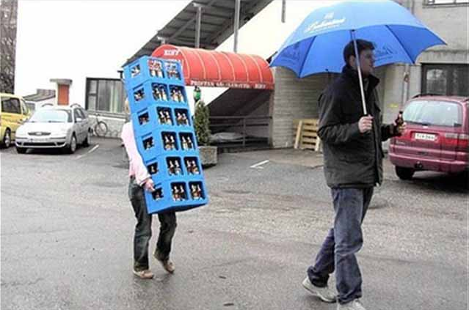
Challenges – ABHR Placement
Notes:
And of course there is also the option of staff carrying their own ABHR

Slide 13
Challenges – ABHR Placement
Notes:
The more places the better, you can not expect HCW to perform HH if it is not easily accessed when the 5 Moments are taking place

Slide 14
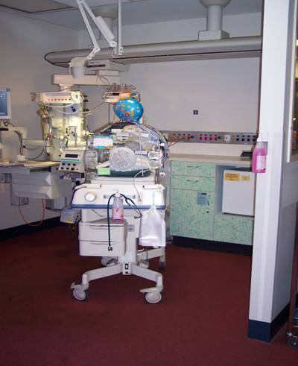
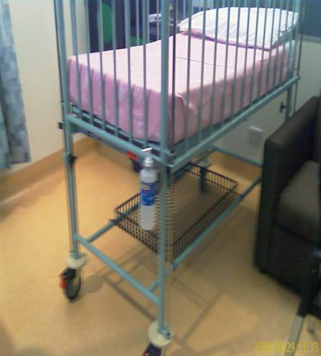
Yes it can be in kids areas…..

Slide 15
All the pieces fit together…
Auditing
Introduce HH Program
Education
&
Interventions
Feedback

Slide 16
Education
Basic Hand Hygiene education should include:
Why is hand hygiene important
Hand hygiene on entering and leaving a patient zone
HH is either ABHR or correct hand wash
If hands visibly soiled then they must be washed
Bottles of ABHR must not be topped up
Gloves are not a substitute for HH
After that, vary your talks for each HCW group
Notes:
Every single HCW (clinical & non clinical) should be educated on these points

Slide 17
Education
Keep your message simple:
Hand hygiene before touching a patient
Hand hygiene after touching a patient
If you do anything invasive:
Hand hygiene before a procedure
Hand hygiene after a procedure or after handling body fluids
Hand hygiene after touching anything in the patient’s room
Notes:
Every single HCW (clinical & non clinical) should be educated on these points

Slide 18
Interventions to Improve HHC
Small or large
May involve:
Policy change
Improving product placement
Improving workflows
Encourage local ownership & new ideas
Address issues & concerns eg. skin care
Notes:
Interventions can be large & focus on the whole facility & governed by the steering committee, or they can be locally owned ward specific interventions, these are often small things that are found when reviewing ward compliance data, but make a huge difference to staff compliance.
It is important to encourage staff to own their Hand Hygiene compliance results & try to come up with some new ideas to imrpove it – “Ask the staff – what is stopping you from being able to do HH when you need to?” this will improve staff understanding of the 5 moments, but also shows people that the program is NOT about blaming or pointing the finger at staff but trying to make it easier for them to keep themselves & the patients safe.
When staff are highlighting barriers & issues to performing HH take these concerns seriously & come up with ways to address these concerns, this will also improve staff buy in.

Slide 19
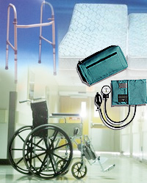
Not just Hand Hygiene
To complement and help sustain your HH culture change program clean all shared equipment between patients
Cleaning product must be readily available at point of use
Notes:
A big part of your education package is the “clean between” program but not a part of your auditing.
BP cuffs, stethoscopes, ID tags, keyboards, phones etc.

Slide 20
All the pieces fit together…
Auditing
Introduce HH Program
Education
&
Interventions
Feedback

Slide 21
Auditing Requirements
For Australian submission of data is 3 x every year
March 31st
June 30th
October 31st
Required Moments depend on the number of acute beds at each healthcare facility
Notes:
Currently we are asking for 3 audits per year

Slide 22
Department Selection - Hospitals
All eligible departments should be audited a minimum of once per year (ideally each audit period)
At least 100-200 moments should be collected in each high risk area each year
Notes:
Currently we are asking for 3 audits per year

Slide 23
Department Selection - Hospitals
Eligible Departments:
High Risk
Critical care, neonatal care, oncology/haematology, transplantation, renal
Standard Risk
Surgical, medical, mixed, maternity, paediatrics, acute aged care, perioperative, ED, radiology, sub-acute
Notes:
Currently we are asking for 3 audits per year

Slide 24
Department Selection - Hospitals
High Risk
Can also include:
Departments with high rates of infection
High prevalence of patients with MROs
Crowded accommodation
Previously low HHC
Notes:
Currently we are asking for 3 audits per year

Slide 25
Department Selection - Hospitals
Other Departments that can be included within an acute care facility:
Ambulatory care, dental, mental health, palliative care, long term care
Departments that should NOT be included:
CSSD, kitchen, laundry, other areas where there are no patients
Notes:
Currently we are asking for 3 audits per year

Slide 26
Required Moments Hospitals
Number of acute inpatient beds | Minimum Total number hand hygiene moments per audit
> 400 | 2450
301 to 400 | 2100
201 to 300 | 1750
151 to 200 | 800
101 to 150 | 600
51 to 100 | 200
25 to 50 | 100
<25 ** | 50
** Auditing in Hospitals < 25 beds is dependent on jurisdiction
Notes:
Currently we are using this number of observations for each hospital but this also will be reviewed at a later stage and hopefully the number can be reduced and still be statistically correct

Slide 27
Ward Selection
HHA don’t recommend routine HHC auditing in these settings:
Non-acute
Community
Mental Health
Resources of HH program are better utilised in other areas:
Product placement
Staff education
Notes:
Auditing wards where there is little staff/patient activity and interaction will result in a small number of moments being observed (i.e. non-acute settings) and resources required to undertake auditing may be better utilised measuring other aspects of a hand hygiene program (e.g product placement, education etc).

Slide 28
Ward Selection
However if you are required to audit in non-acute areas
HHA recommend auditing in:
High risk areas
Procedure rooms
Medication rooms
ECT suites
Single patient contact/treatment rooms
Patient observations
Wound dressings

Slide 29
Data Collection
Allow time to collect the recommended number of Moments for your facility
Decide on how many auditors will be used
Auditors must be trained & validated as per HHA guidelines
If you require further Auditors, you can train them or they can attend a HHA workshop
Collect data until target number of Moments are met for each area

Slide 30
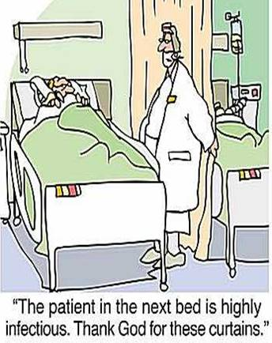
How do I do it?
Ideally work in pairs initially
Inform ward manager of your presence
Early in shift, more action likely
Position yourself to see the patient zone, sink/ABHR, & HCW
Don’t compromise patient care
Curtains - to peek or not to peek???
Talk openly to HCWs and patient’s
Notes:
After watching the training video , practice your auditing in a controlled environment then it’s a good idea to go up to the wards in pairs and both watch the same HCW. Don’t talk to each other whilst observing but then compare that you have both recorded the same numbers of observations. If not then go back to the video and watch it again then repeat this exercise.Once you are all doing it the same way then you can begin your auditing.
It also helps you to know your forms as sometimes things happen in a rush and you wont want to miss any opportunities to record a moment because you cant find where it goes on the sheet.
Early in each shift more likely to be more action happens( especially early in the morning), showers, physios, observations,medications DRs rounds etc much slower in afternoons as usually visitors everywhere
But also be very conscious not to follow the same HCW around each day, need to vary who you observe to get a true history of the ward, try to observe all classifications of HCWs ,eg allied health, PSA, DRs and RN
You can observe in single rooms but we recommend multi bed bays as this gives the HCW the most opportunities to go pt to pt therefore more moments for observing, the exception being ICU

Slide 31
Hawthorne Effect
“ …the presence of recognized observers has little influence on low-performing staff. However, as healthcare facilities achieve higher levels of HH performance, it may be necessary to deploy covert observers who are unrecognizable to staff, to verify ongoing good performance…. the Hawthorne effect becomes an effective tool for sustaining improvement…."
Variability in the Hawthorne Effect With Regard to Hand Hygiene Performance in High‐ and Low‐PerformingInpatient Care Units Kohli et al.
Infection Control and Hospital Epidemiology March 2009,Vol 30,No.3
Notes:
We always get asked about the hawthorne effect and in the long run it makes little difference really as although they know you are watching and observing they will still get it wrong, you will see them wash at the wrong times or even wash their gloves to impress you
The more you audit the less people will notice you & revert to normal practice.

Slide 32
All the pieces fit together…
Auditing
Introduce HH Program
Feedback
Education
&
Interventions

Slide 33
What Do I Do With This Data?
Local Level:
Must be fed back to hospital executive
Must be fed back to staff
Celebrate the successes
Look for opportunities to improve
Encourage healthy competition
Notes:
Feed back data at a ward level & at an executive level, this provides everyone with a sense of responsibility for their data
Celebrate successes – monitor the data for improvements after interventions - & celebrate improvements
Use data to focus on HCW group or Moment specific change – eg. This month we will focus on Moment 1 because that is where we are not very compliant
At a national level you need to submit data to HHA via State or Project coord
Facilities are provided with national & jurisdictional benchmarks

Slide 34
