Slide 1
Compliance Database

Slide 2
Session Objectives
How to login
Update profile
Define User Roles
Outline the use of HHCApp
Options for data entry
Mobile devices

Slide 3
How to Log in to HHCApp
Your lead hand hygiene person (or HHA) will provide your username and password
First login should be on a computer
Login is case sensitive
Password requires one capital
Forgotten password function requires
Username
Email attached to profile

Slide 4
HHCApp Website
For the computer version:
https://compliance.hha.org.au/

Slide 5
Defining User Roles
There are two main user roles for an organisation:
Administrator
Allocated by HHA initially
Auditor
Allocated by the administrator
Notes:
There has been people who have logged on as an auditor and wondered why they can’t manage audits, audit periods, departments etc

Slide 6
Other HHCApp User Roles
Data entry
Can enter data for the level they have been allocated to
Reporter
Can view reports for the level they have been allocated to

Slide 7
Administrator
Can:
Create and manage local audit periods
Manage local and national audits
Enter data
View organisation wide reports
Manage departments
Manage users
When logged in as the Administrator, you will see:

Slide 8
Admin Home Page
Org Admin Name
Hospital Name

Slide 9
Auditor Role
Roles for Auditors in HHCApp:
Enter data only
When logged in as an Auditor, the home page will look like:

Slide 10
Auditor Home Page

Slide 11
Auditor Home Page
Previously entered data
Add new data here

Slide 12
Update HHCApp Profile
Click on your name in the top right hand corner to update your profile

Slide 13
Update HHCApp Profile

Slide 14
How to enter data –Admin
If data is collected on paper
Login to HHCApp
Click on the Sessions tab in the menu
Click on Add Session +

Slide 15
How to enter data - Auditor
If data is collected on paper
Login to HHCApp
From the auditor home page
Click on Add Session

Slide 16
Add New Session
Enter the details of the session

Slide 17
Add New Session
Enter the details of the session
Choose an organisation if you are linked to more than one hospital

Slide 18
Add New Session
Enter the details of the session
Choose an audit
NHHI Audit
OR
Local Audit

Slide 19
Add New Session
Enter the details of the session
Choose an auditor to put the data against.
PLEASE NOTE:
If the auditor name is not on the list, DO NOT add the data to another auditor’s name.
Create a new auditor, then go back and enter their data

Slide 20
Add New Session
Enter the details of the session
Choose a ward / department

Slide 21
Add New Session
Enter the details of the session
Session number is optional.
Use this only if you are keeping a running tally on paper of sessions for each department

Slide 22
Add New Session
Enter the details of the session
Dates and times to be entered as per paper audit sheet

Slide 23
Add New Session
Enter the details of the session
Once completed press save

Slide 24
Entering Moments
Once the session information has been saved you will see the fields for moment data entry

Slide 25
Entering Moments
Set up for quick keyboard entry
Use starting letter / number and tab key to select and move between fields
You can also use the mouse to click the dropdown boxes and select the required field

Slide 26
Entering Moments
The running tally of moments is updated each time a moment is saved
Ensure this matches the totals on your paper audit

Slide 27
Entering Moments
When you have finished just navigate away from the page using the menus
No need to click save again unless you have changed any of the session information since you last saved it.

Slide 28
Org Admin/Reporter Home Page

Slide 29
View Reports
Only users allocated Admin or Reporter roles can run reports

Slide 30
View Reports
The reports can be downloaded as:
PDF
MS Excel
CSV
Graphs can be saved as images
Home page dashboards can be printed for chosen audit period

Slide 31
By Department
Notes:
Report gives the overall compliance rates for each department

Slide 32
By HCW Type
Notes:
Gives the overall compliance rate for each HCW Type. Can use the filter to select individual departments.

Slide 33
By Moment
Notes:
Gives the overall compliance rate for each Moment. Can use the filter to select individual departments and individual HCW Types.

Slide 34
Auditor and Sessions

Slide 35
Department Poster

Slide 36
Department Poster
Dept Name and Date Range

Slide 37
Zero Reports
All reports now have the option to “include XX with no data”

Slide 38
Custom Reports

Slide 39
Custom Reports
Aim to
Provide more flexibility for producing HH reports

Slide 40
Snapshot Report

Slide 41
Trend Report

Slide 42
Exports Tab
All reports run are automatically emailed to the user and can be found on the exports tab for up to 7 days

Slide 43
Use of Reports
Data Validation
Look for outliers
Feedback / Education
Look for trends
Within one area
Over time
Use Auditor and Session report
Confirm 100 moments collected each year
Review HHC by auditor

Slide 44
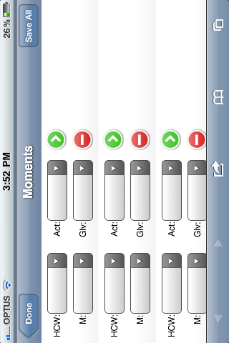
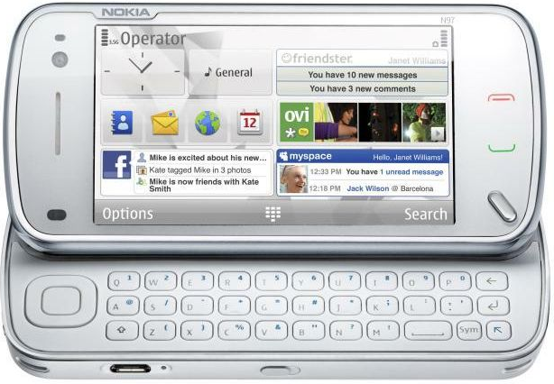
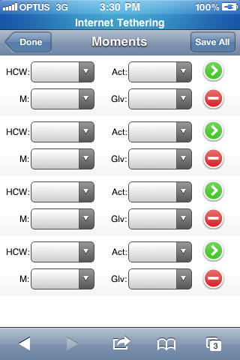
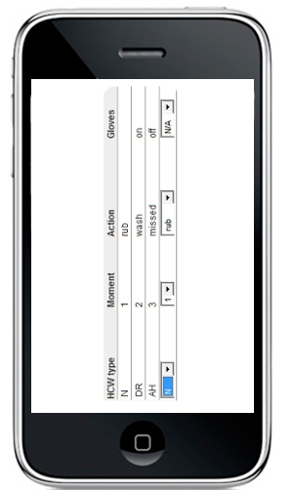
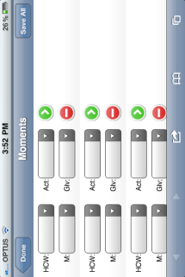
Direct web entry from enabled devices

Slide 45
Use a mobile device!
Cut data entry time by half
Have less data entry errors
Allow multiple auditors to enter data at once
More discrete data collection

Slide 46
Direct web entry from enabled devices
Can be accessed via the internet browser on your device (Apple or Android)
Web address is https://compliance.hha.org.au/mobile/
The device only needs to be connected to the internet or the first time you login and when you “Sync” your completed session(s)
You must use your personal username to login

Slide 47
Practice with Mobiles
https://compliance.hha.org.au/mobile/
Username and password fields are case sensitive so capitals are important
Username: Ignaz
Password: Ignaz1

Slide 48
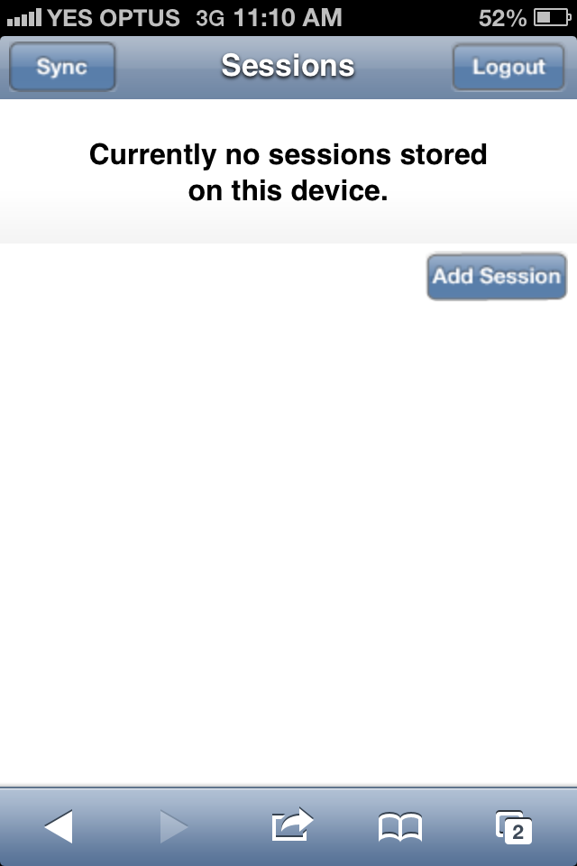
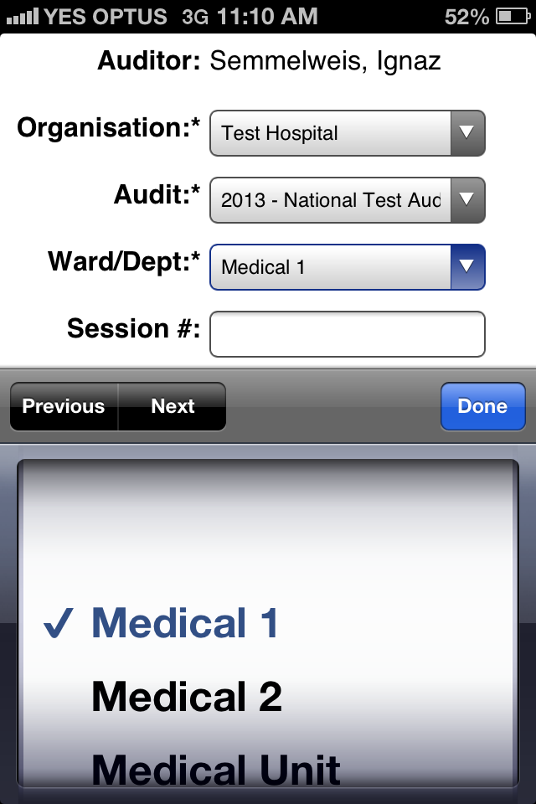
Log In
Login with your personalised login
Add data by pressing Add Session
Choose the audit and dept you are going to start auditing on
Notes:
Select Add Session to start a new session
Select the required session information

Slide 49
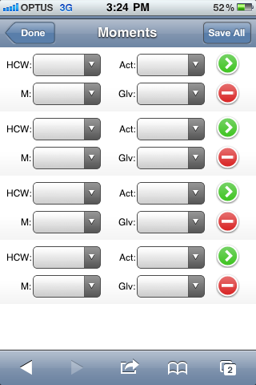
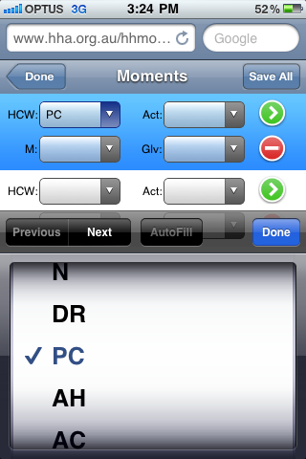
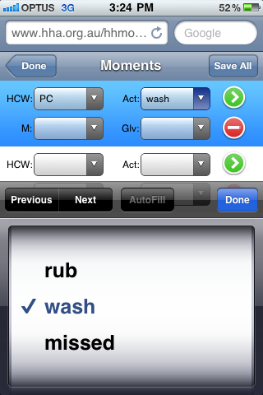
Enter HH data
This page is like the paper data form
Fill in the moment data:
HCW, Action, Moment, Gloves
Notes:
Select the required values

Slide 50
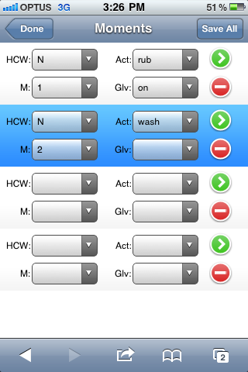
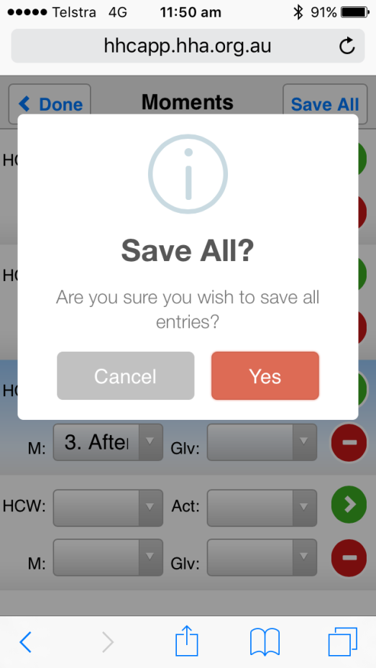
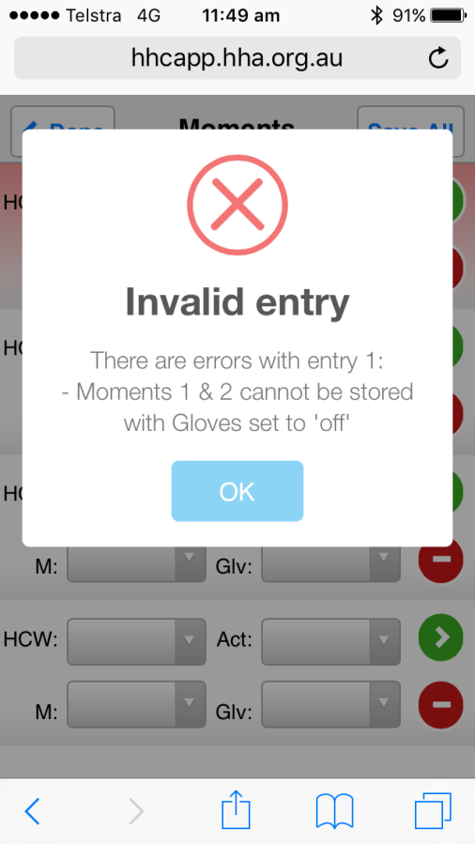
Save Data
Save all moments by using Save All
Save one moment at a time by using the green arrow
Data validation rules assist with accurate data collection
Notes:
Two options for saving and clearing a completed moment
Select the green arrow next to the completed moment to save the single entry; or
Select Save All to save all the completed moments
Any moments that have errors will be highlighted in red with an error message explaining what is wrong
When your session is completed, select done

Slide 51
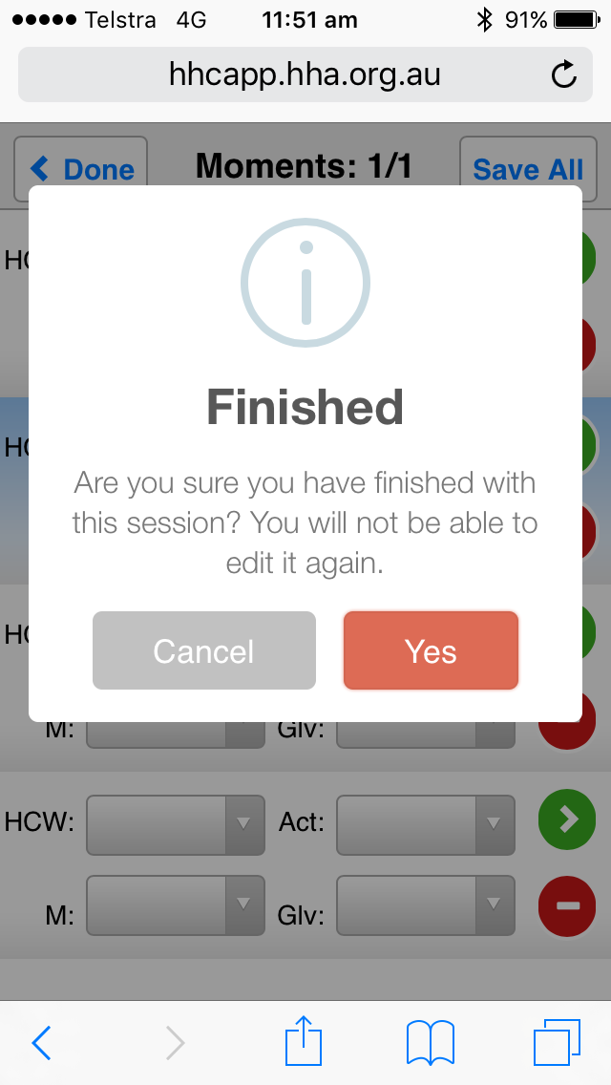
Finish Collecting Data on One Ward
Finished collecting data – press Done
Notes:
Two options for saving and clearing a completed moment
Select the green arrow next to the completed moment to save the single entry; or
Select Save All to save all the completed moments
Any moments that have errors will be highlighted in red with an error message explaining what is wrong
When your session is completed, select done

Slide 52
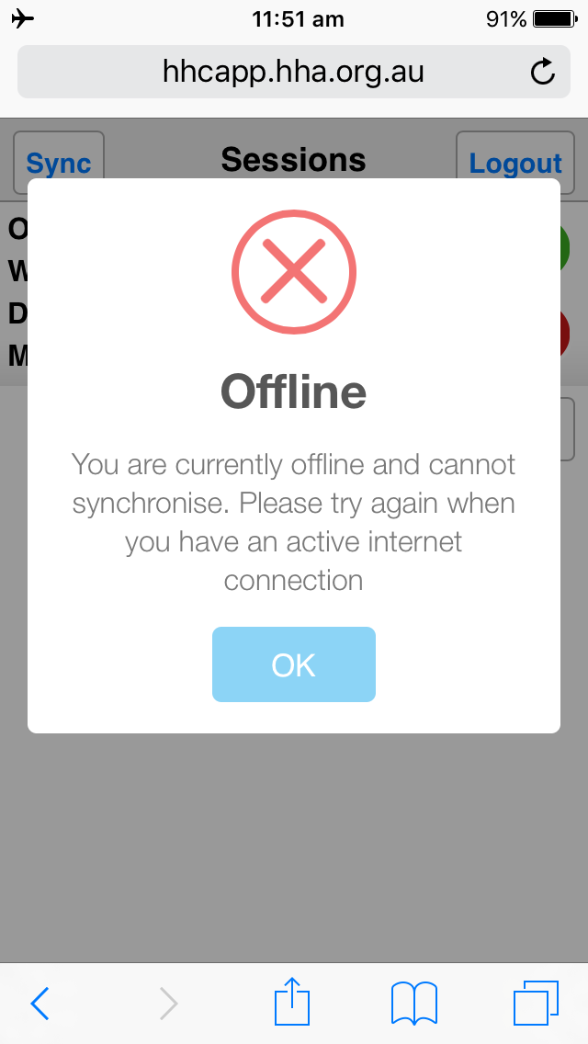
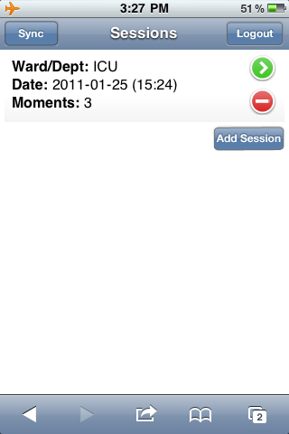
Syncing data
Finished data collection session on one ward – sync data with database before collecting more data
Need to be connected to the internet to enable syncing with the database
Notes:
Now on the sessions screen will be the completed session ready to be “Synced” to HHCApp
If you are offline you won’t be able to sync the session
If you are online, the session will be cleared from your device

Slide 53
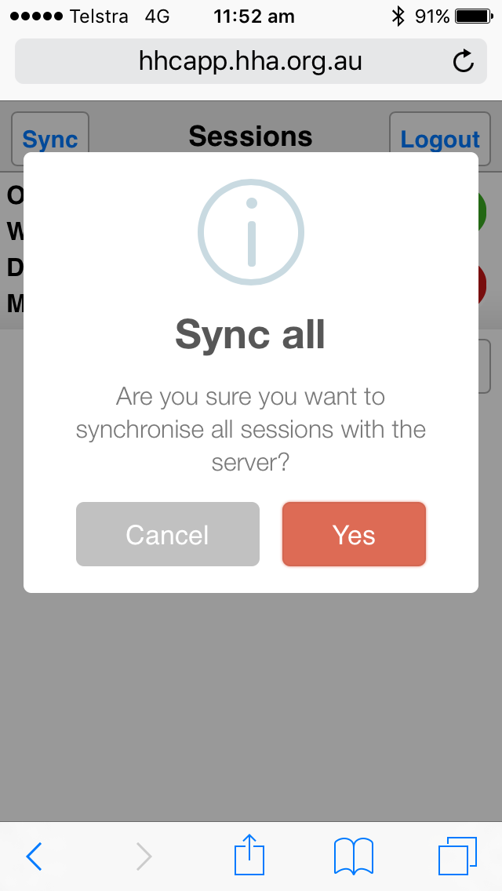
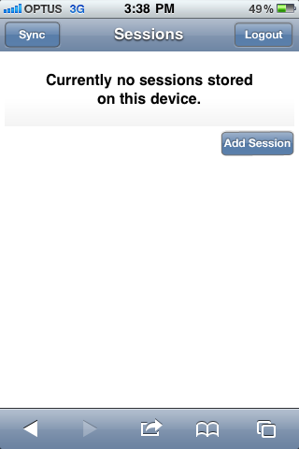
Syncing data
Sync was successful if you return to this page

Slide 54
Always Log Out
After you have finished data collection and you have synced your data ensure that you LOG OUT
Closing the internet browser does not log you out

Slide 55
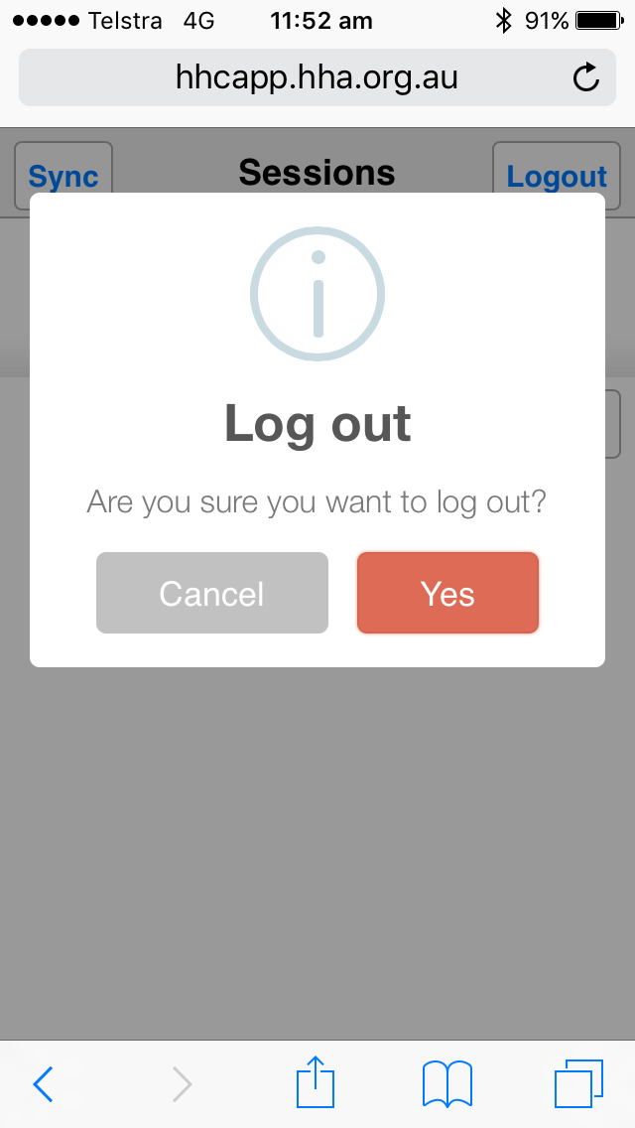
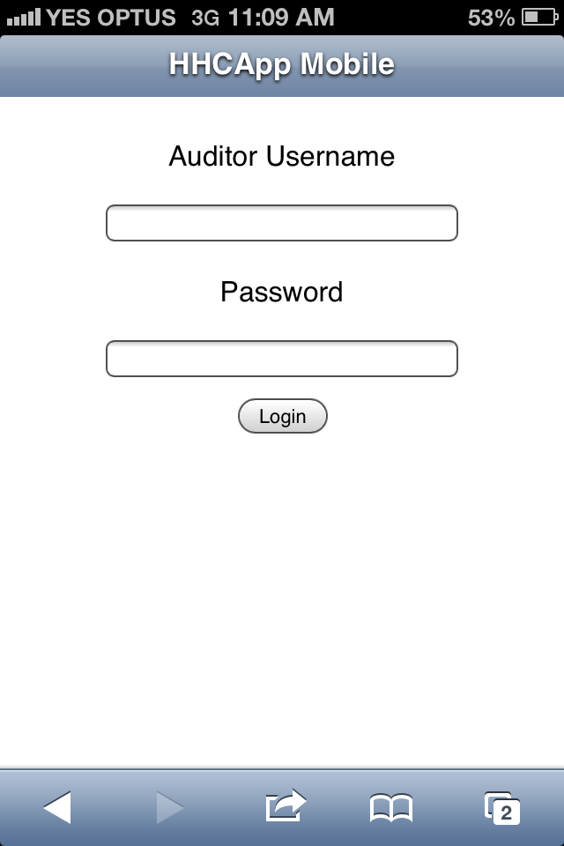
Correct Log out
Logging out successfully returns you to the login page
Log out by pressing the Logout button

Slide 56
HHCApp Instructions
The written instructions are the best resource to learn how to use HHCApp
These can be accessed via the HHA website on the Hand Hygiene Compliance Application page.
https://www.hha.org.au/audits/compliance-database/instructions
They cover data entry for HHCApp in a simple step-by-step manner
HHA are also available for assistance when required

