Slide 1
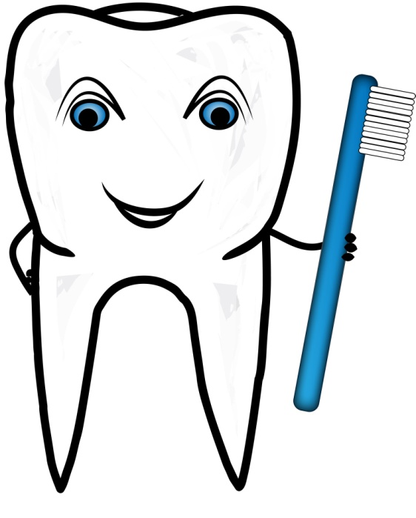
HAND HYGIENE MOMENTS
SWSLHD ORAL HEALTH SERVICES
FOR DENTAL ASSISTANTS

Slide 2
Ask patient to have a seat
Notes:
You have not touched the patient yet

Slide 3
Moment 1
Perform hand hygiene before touching the patient
Notes:
By performing hand hygiene before touch a patient, you reduce the risk of harmful pathogens being transferred to the patient

Slide 4
Place bib on patient
Notes:
You are now safe to perform non-invasive procedure as required

Slide 5
Hand glasses to patient
Notes:
You can perform all non- invasive procedures that require touching the patient, as long as you do not leave the patient zone or come into contact with blood or body fluids

Slide 6
MOMENT 4
Perform hand hygiene after touching
the patient
Notes:
Hand hygiene is performed at this point to protect you from harmful pathogens that may have been transferred to your hands by touching the patient

Slide 7
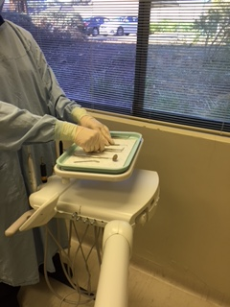
MOMENT 2
Put on gloves to set up examination instruments
NOTE*: If you need to move out of the patient/contaminated zone to collect equipment you will need to perform hand hygiene again before donning gloves IMMEDIATELY prior to setting up.
Notes:
Setting up is considered a procedure, so you need to perform hand hygiene immediately before setting up to avoid contamination of the packaging and surrounding surfaces, which could transfer to the instruments when removing them from the pack.
You do not need to perform hand hygiene again if you did not touch anything after Step 5
For auditors this is considered a ‘bonus moment’

Slide 8
MOMENT 2
If you are assisting with a procedure , perform hand hygiene, put on gloves and prepare for the procedure.
Notes:
Setting up is considered a procedure, so you need to perform hand hygiene immediately before setting up to assist maintain the sterility of the instruments and procedural are

Slide 9
Put on mask and then eye protection
Notes:
Your hands are clean, so you can safely start putting on your PPE

Slide 10
MOMENT 3
If at any time during the procedure you need to move OUT of the contaminated zone you MUST remove gloves and perform hand hygiene immediately.
Notes:
Hand hygiene is required because you are leaving the patient zone and will touch the client’s medical record, which we try to keep as clean as possible.

Slide 11
Complete the clinical assessment
Notes:
You are now out of the patient zone and in a clean area

Slide 12
MOMENT 2
Perform hand hygiene before putting on gloves immediately prior to (returning to assist with) the procedure
Notes:
You perform hand hygiene immediately before a procedure to reduce the risk of transferring harmful pathogens that have the opportunity to bypass the body’s natural defences during a dental procedure

Slide 13
Put on gloves
Notes:
Gloves can protect both patients and HCWs from exposure to infectious agents that may be carried on hands
Gloves do not provide complete protection against hand contamination. Pathogens may gain access to the HCWs hands via small defects in gloves or by contamination of the hands during glove removal.

Slide 14
Start the procedure

Slide 15
Remove bib from patient at completion of procedure
Notes:
As the bib is likely contaminated with blood and/or body fluids from, it should be removed before removing the dirty tray of instruments

Slide 16
Take dirty tray to the sterilising room
Notes:
The tray must be removed from the surgery immediately after removing the bib to prevent any risk of blood or body fluid exposure

Slide 17
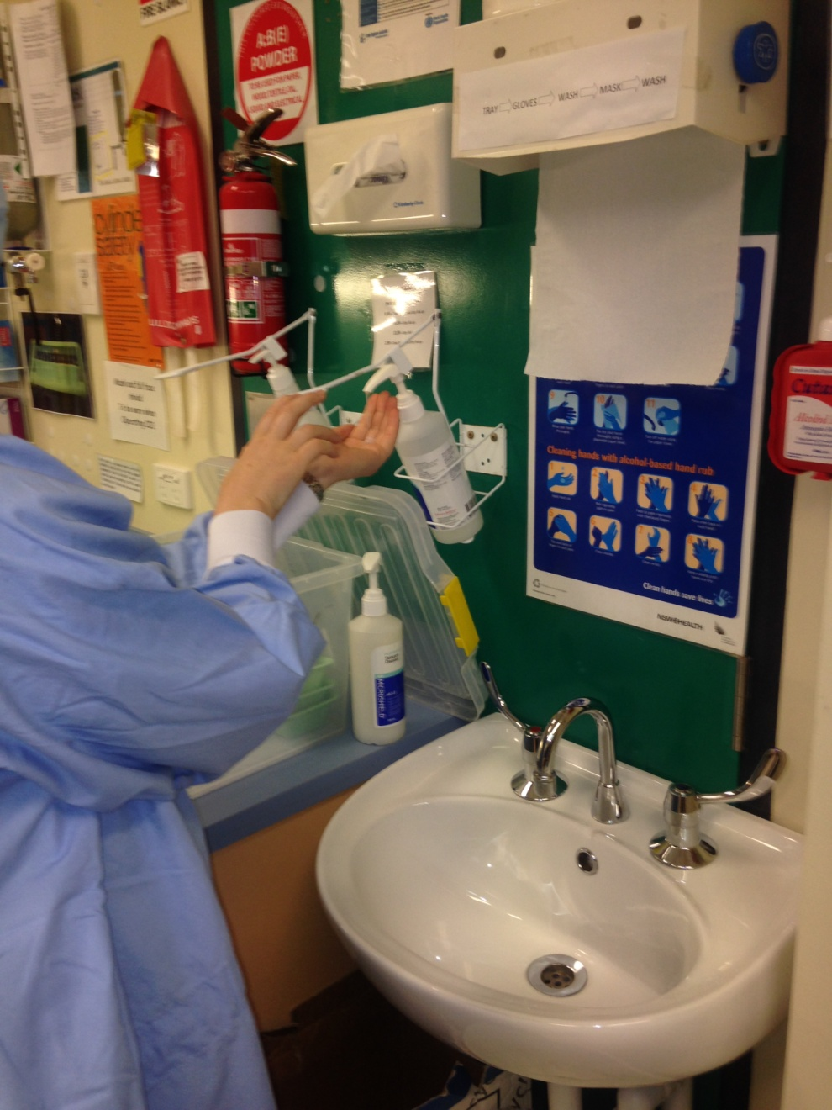
MOMENT 3
Remove gloves and perform hand hygiene immediately after blood and body fluids risk from instruments and gloves
Notes:
Hand hygiene is performed to protect the dental assistant from exposure to blood borne viruses in blood and body fluids as well as other infectious pathogens

Slide 18
Remove eye protection then mask
Notes:
Your hands are clean, so you can safely remove your PPE

Slide 19
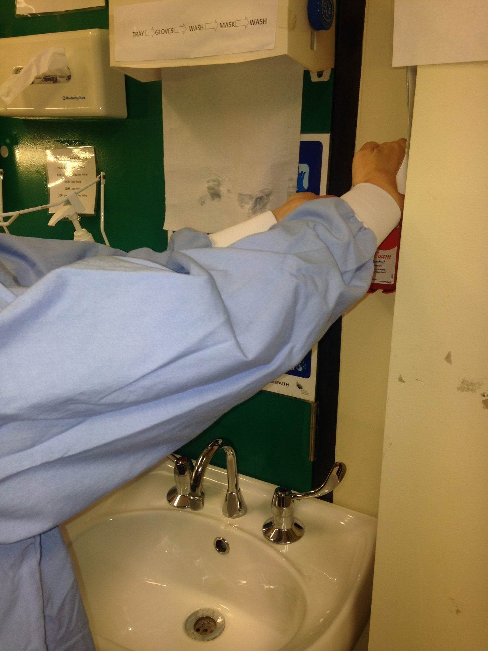
MOMENT 3
Perform hand hygiene immediately after blood and body fluids risk
from mask and eye protection
Notes:
Hand hygiene is performed after removal of mask and face protection to protect you from the transfer of harmful pathogens that may have contaminated this equipment during the procedure and then transfer onto your hand during removal

Slide 20
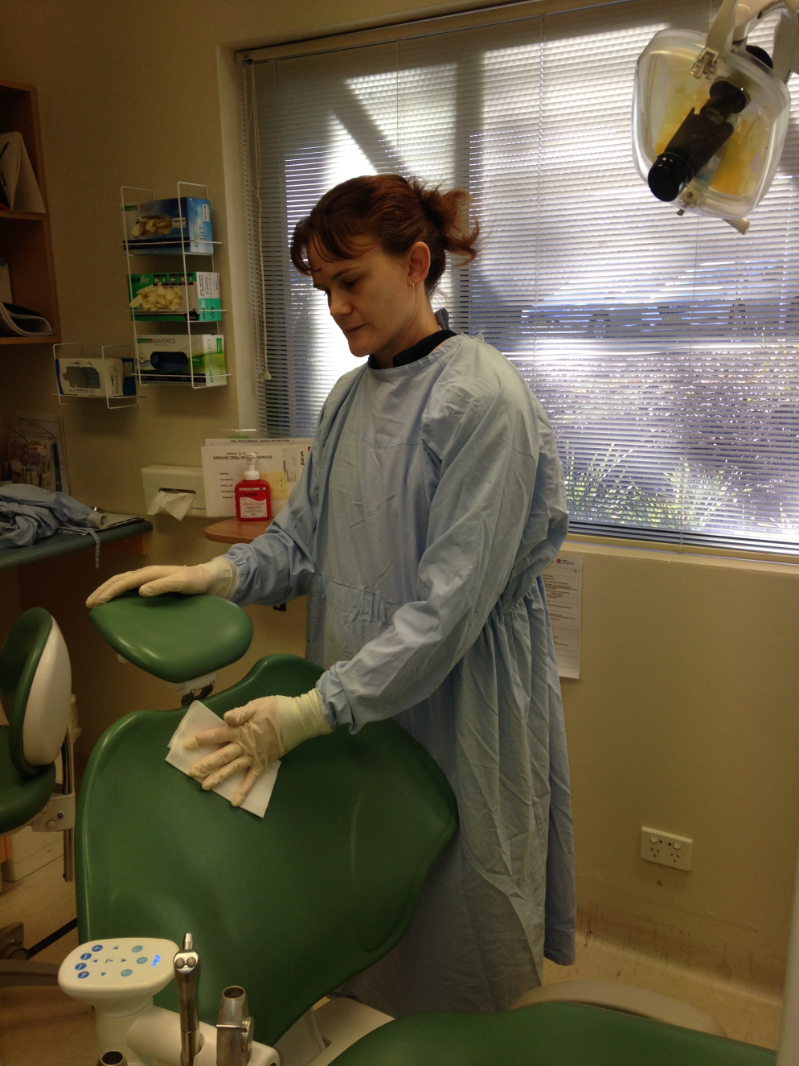
Clean patient zone wearing gloves
Notes:
Wearing gloves for cleaning procedures reduces the amount of contamination on your hands and protects your hands from the chemicals in cleaning agents

Slide 21
MOMENT 5
Remove gloves and perform hand hygiene after touching the patient zone
Notes:
Perform hand hygiene after cleaning to protect yourself from harmful pathogens that may contaminate your hand via imperfections in the gloves or during glove removal

