Slide 1
5 Moments for Hand Hygiene
Based on the 'My 5 moments for Hand Hygiene', URL: http://www.who.int/gpsc/5may/background/5moments/en/index.html © World Health Organization 2009. All rights reserved.

Slide 2
Session objective
Introduce the concept of micro-organism transmission
Identify the 5 Moments
Define the 5 Moments for Hand Hygiene and related terminology

Slide 3
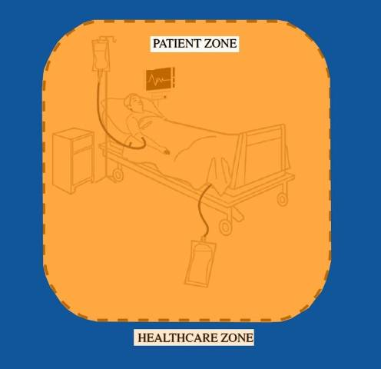
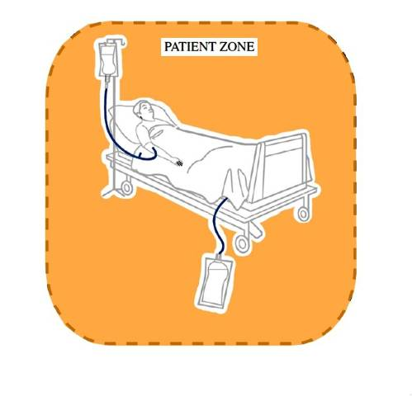
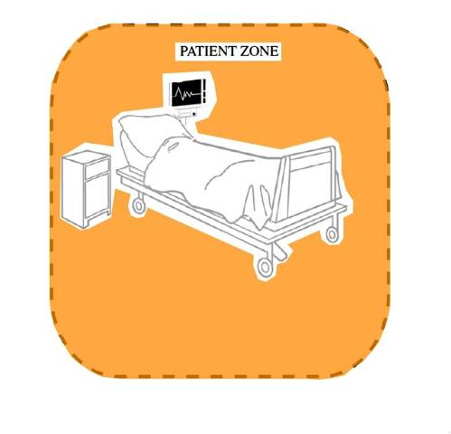
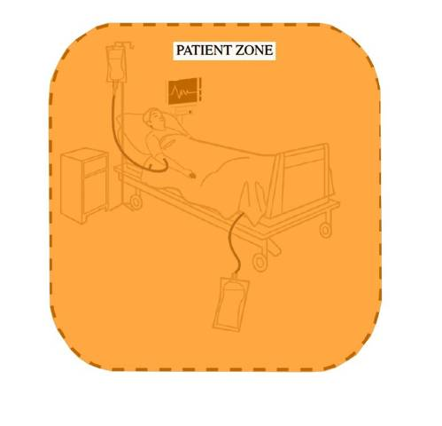
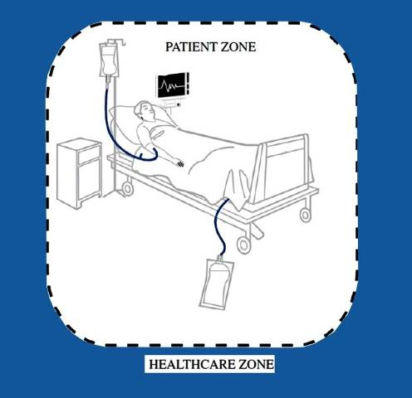
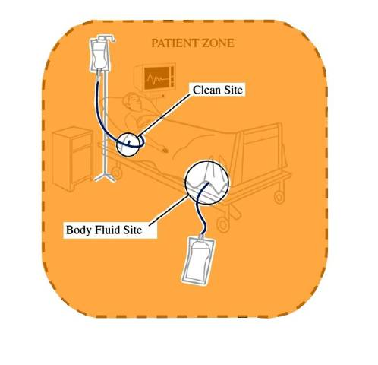
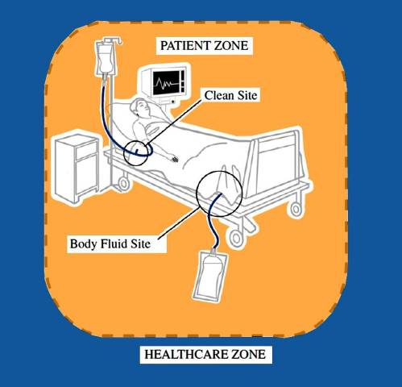
Two Zones
The Healthcare Zone
The Healthcare Zone
The Patient Zone:
The patient &
The patient’s immediate surroundings
Two Critical Sites
Clean site
Body fluid site
Notes:
Patient Zone (orange area) includes the patient & the patient’s immediate surroundings within that zone there are 2 critical sites

Slide 4
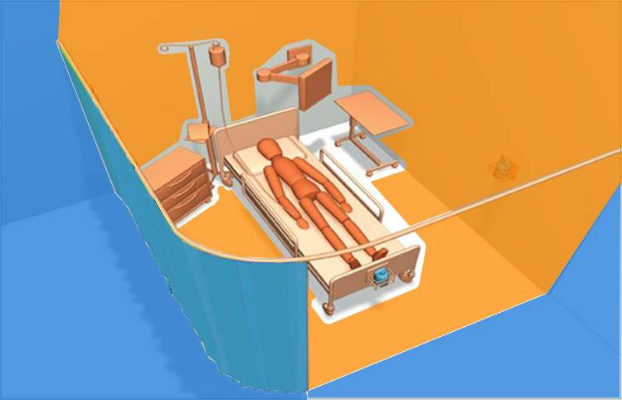
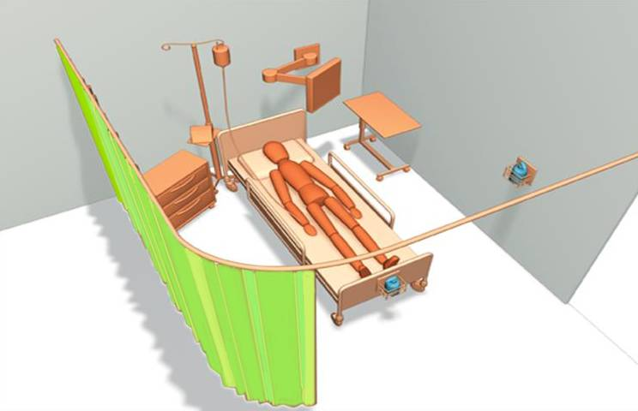
Patient Zone
From Ontario Just Clean Your Hands Program
The science behind Just clean your hands presentation

Slide 5
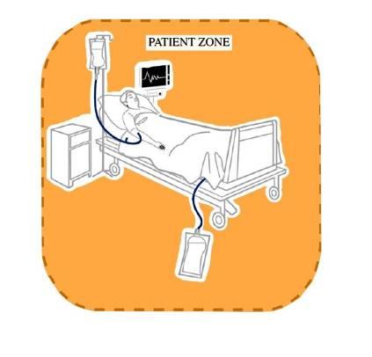
Patient Zone
Assumptions
Patient flora rapidly contaminates entire patient zone
Patient zone is cleaned between patients
Notes:
Assumptions are generally made that within the pt zone
Patient flora rapidly contaminates entire patient zone
Patient zone is cleaned between patients

Slide 6
Healthcare Zone
Assumptions
Contaminated with organisms foreign and potentially harmful to Patient X
Transmission results in exogenous infection
Notes:
Assumptions are generally made that within the healthcare zone
That contaminated with organisms foreign and potentially harmful to Patient X occur
Transmission results in exogenous infection

Slide 7
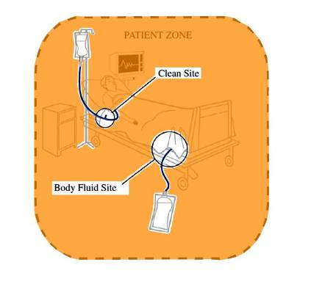
Critical sites
Clean sites
Have to be protected against microorganisms
Body fluid sites
Lead to hand exposure of body fluids
Notes:
Anywhere we there is portal for entry of micoorganisms we need to be conscious of and protect

Slide 8
The facts
Colonised or infected patients represent the main reservoir for healthcare associated microorganisms
Environment in the healthcare facility contains a wide variety of different healthcare-associated micro-organisms and represents a secondary source for transmission to patients
The immediate patient environment becomes colonised by the patient flora

Slide 9
The facts
Most transmission of microorganisms results in colonisation, not infection
Most HCAIs, however, are of an endogenous nature, and due to micro-organisms already colonising the patient before the onset of infection
Notes:
Make link between colonisation of patient from HCW hands which can then lead to infection

Slide 10
Four negative outcomes targeted by hand hygiene
Cross colonisation of patients
Endogenous and exogenous infection in patients
Infection in HCWs
Cross-colonisation of the healthcare environment including HCWs

Slide 11
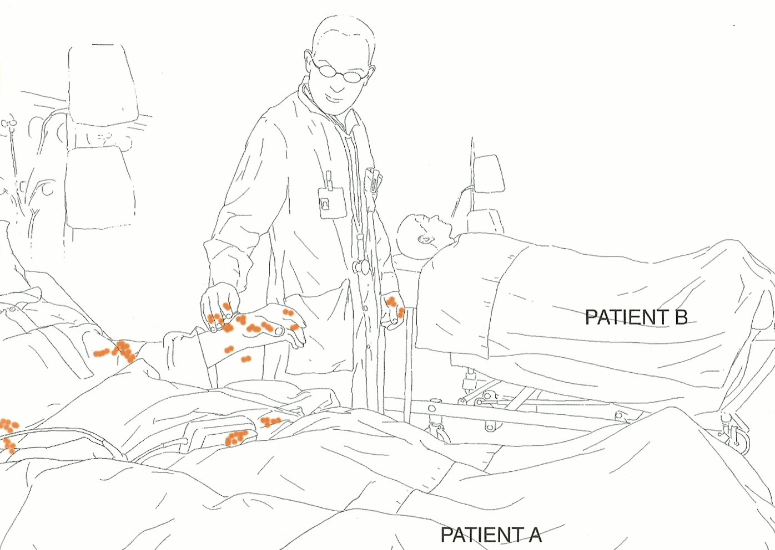
Possible cross contamination between Patient A and Patient B

Slide 12
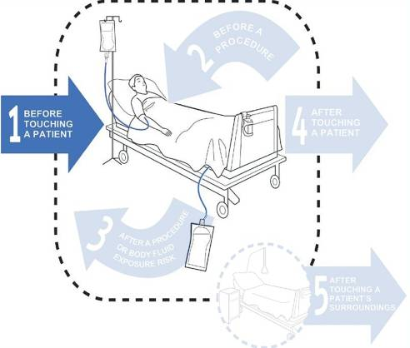
Moment 1 – Before Touching a Patient
Prevented negative outcome:
Patient colonisation with health-care microorganisms, exogenous infection

Slide 13
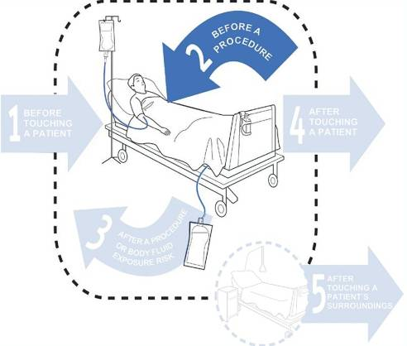
Moment 2 – Before A Procedure
Prevented negative outcome:
Patient infection, endogenous/exogenous
HCWs generally touch another surface within the patient zone before contact with a clean site

Slide 14
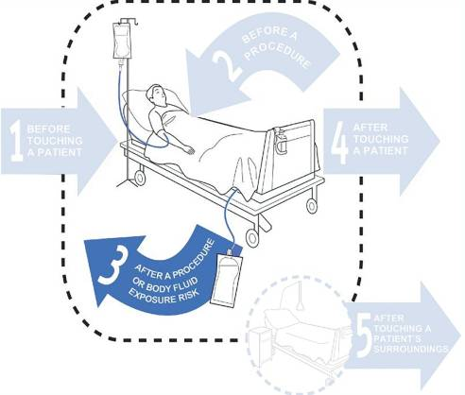
Moment 3 After A Procedure or Body Fluid Exposure Risk
Prevented negative outcome:
Healthcare worker infection, environmental contamination
Prevents transmission of microorganisms from a colonised to a clean body site on patient X

Slide 15
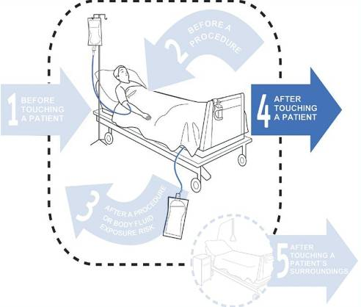
Moment 4 – After Touching A Patient
Prevented negative outcome:
Healthcare worker colonisation, environmental contamination
Minimises dissemination to healthcare environment

Slide 16
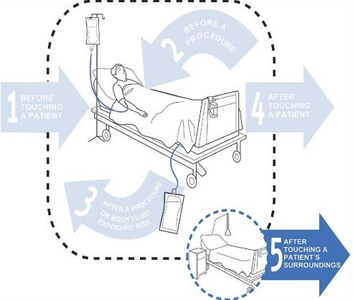
Moment 5 – After Touching A Patient’s Surroundings
Prevented negative outcome:
Healthcare worker colonisation, environmental contamination
Minimises dissemination to healthcare environment

Slide 17
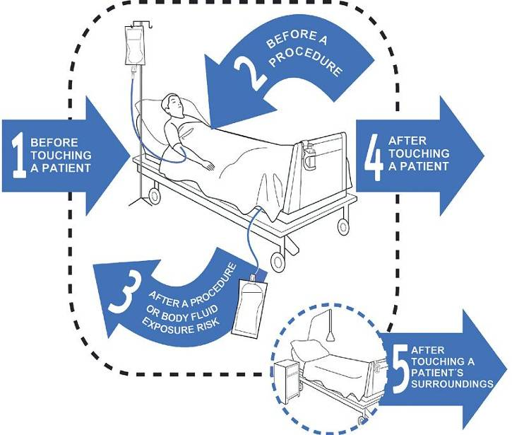
The 5 Moments

Slide 18
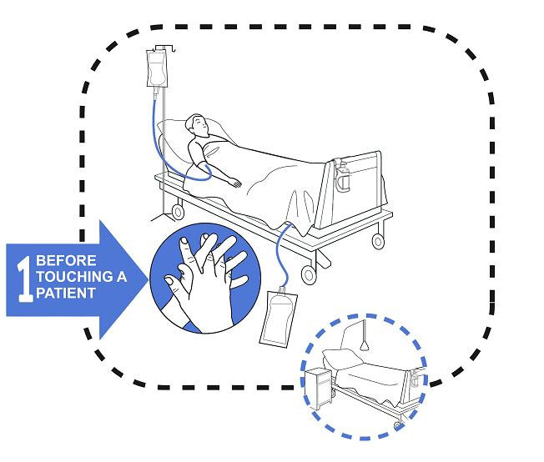
Moment 1 Before touching a Patient Touching a Patient

Slide 19
Patient
Refers to any part of the patient, their clothes, or any medical device that is connected to the patient
If the patient were to get out of bed and walk off – what would still be attached to them?

Slide 20
Moment 1
When: | Examples:
Touching a patient in any way | Shaking hands, Assisting a patient to move, most Allied health interventions, Touching any medical device connected to the patient (e.g. IV pump, IDC)
Any personal care activities | Bathing, Dressing, Brushing hair, Putting on personal aids e.g. Glasses
Any non-invasive observations | Taking a pulse, Blood pressure, Oxygen saturation, Temperature, Chest auscultation, Abdominal palpation, Applying ECG electrodes, CTG
Any non-invasive treatment | Applying an oxygen mask or nasal cannula, Fitting slings/braces, Application of incontinence aids (including condom drainage)

Slide 21
Moment 1
When: | Examples:
Preparation and administration of oral medications | Oral medications, Nebulised medications
Oral care and feeding | Feeding a patient, Brushing teeth or dentures

Slide 22
Key Message for Moment 1
Hand Hygiene before touching a patient
Where possible Hand Hygiene should occur in front of the patient so that they can observe it
Hand Hygiene on entering the patient’s room

Slide 23
Example Moment 1
HCW walks in ,helps patient to sit up, moves over bed table, folds down sheets, moves the chair into position, then assists patient out of bed
Moment 1-prior to touching the patient

Slide 24
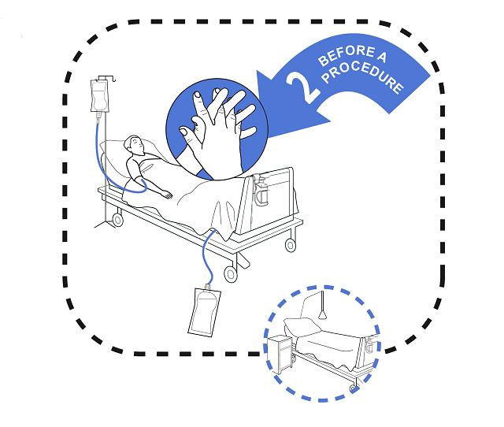
Moment 2 Before a Procedure

Slide 25
Procedure
Is an act of care for a patient where there is a risk of direct introduction of a pathogen into the patient’s body.

Slide 26
Moment 2
When: | Examples:
Insertion of a needle into a patient’s skin, or into an invasive medical device | Venipuncture, Blood glucose level, Arterial blood gas, Subcutaneous or Intramuscular injections, IV flush
Preparation and administration of any medications given via an invasive medical device, or preparation of a sterile field | IV medication, NGT feeds, PEG feeds, Baby tube feeds, Dressing trolley
Administration of medications where there is direct contact with mucous membranes | Eye drop installation, Suppository insertion, Vaginal pessary

Slide 27
Moment 2
When: | Examples:
Insertion of, or disruption to, the circuit of an invasive medical device | Procedures involving the following: ETT, Tracheostomy, Nasopharyngeal airways, Suctioning of airways, Urinary catheter, Colostomy/ileostomy, Vascular access systems, Invasive monitoring devices, Wound drains, PEG tube, NGT, Secretion aspiration
Any assessment, treatment and patient care where contact is made with non-intact skin or mucous membranes | Wound dressings, Burns dressings, Surgical procedures, Digital rectal examination, Invasive obstetric and gynaecological examinations and procedures, Digital assessment of newborns palate

Slide 28
Key Message for Moment 2
Hand Hygiene immediately prior to a procedure
Once Hand Hygiene has been done, nothing else in the patient’s environment should be touched prior to the procedure starting

Slide 29
Example: Moment 2 HCW replaces an empty IV fluid bag with a new IV fluid bag
Moment 2 – prior to disconnecting the IV line

Slide 30
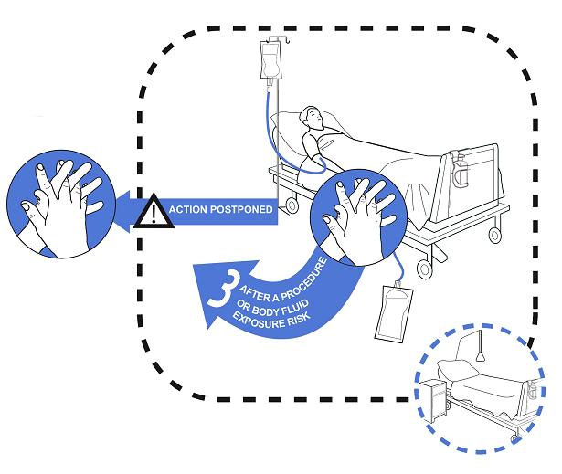
Moment 3 After a Procedure or Body Fluid Exposure Risk

Slide 31
Body Fluid Exposure Risk
Any situation where contact with body fluids may occur. Such contact may pose a contamination risk to either the HCW or the environment

Slide 32
Actual or potential contact with:
Blood, Lochia
Saliva or tears
Mucous, wax, or pus
Breast milk, Colostrum
Vomitus
Urine, faeces, semen, or meconium
Pleural fluid, ascitic fluid or CSF
Tissue samples, including biopsy specimens, organs, bone marrow, cell samples

Slide 33
Moment 3
When: | Examples:
After any Moment 2 | See Moment 2
After any potential body fluid exposure | Contact with a used urinary bottle / bedpan, Contact with sputum either directly or indirectly via a cup or tissue, Contact with used specimen jars / pathology samples, Cleaning dentures, Cleaning spills of body fluid from patient surroundings, After touching the outside of a drain

Slide 34
Key Message for Moment 3
Hand Hygiene immediately after a procedure or a body fluid exposure risk
As hands are likely to be contaminated with body fluid

Slide 35
Example: Moment 3 HCW replaces an empty IV fluid bag with a new IV fluid bag
Moment 2 – prior to disconnecting IV
Moment 3 – after reconnecting IV

Slide 36
Example: Moment 3 HCW walks into the room, empties IDC drainage bag, disposes of urine in pan room
Moment 2 – before opening IDC
Moment 3 – after disposing of urine (exposure risk)

Slide 37
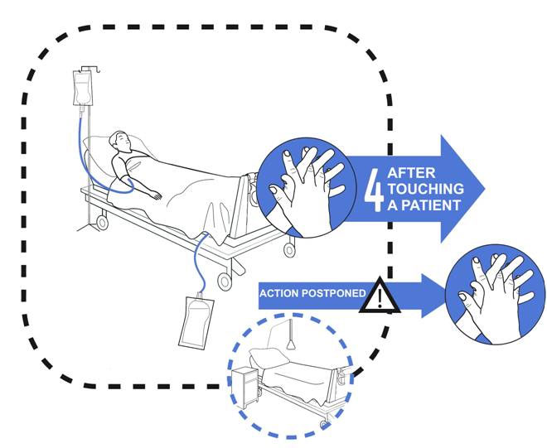
Moment 4 After Touching a Patient

Slide 38
Key Message for Moment 4
Hand Hygiene after touching a patient
This completes the basic message of Hand Hygiene before you enter the patient room, and before you leave the patient room

Slide 39
Example: Moment 4 HCW walks in, helps the patient to sit up, folds down the sheets, moves the chair into position, then gets the patient out of bed, then leaves the room
Moment 1 – prior to touching patient
Moment 4 – after touching the patient

Slide 40
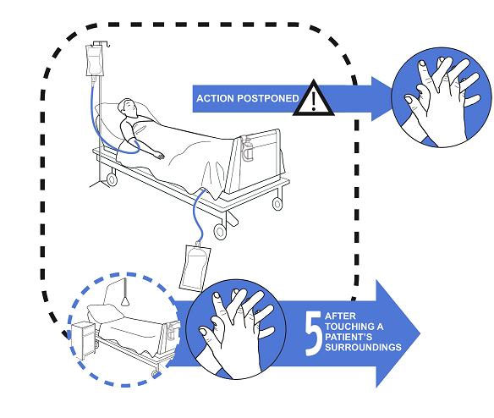
Moment 5 After touching a patient’s immediate surroundings when the patient has not been touched

Slide 41
Immediate Patient Surroundings
A space temporarily dedicated to an individual patient for that patient’s stay
Includes:
Patient furniture and personal belongings
Medical equipment – BP machine, monitor
Medical chart
Anything touched by HCW while caring for that patient

Slide 42
Moment 5
When: | Examples:
After touching the patient’s immediate surroundings when the patient has not been touched | Patient surroundings include: Bed, Bedrails, Linen, Table, Bedside chart, Bedside locker, Call bell/TV remote control, Light switches, Personal belongings, Chair, Foot stool, Monkey bar

Slide 43
Key Message for Moment 5
Hand hygiene after touching the patient’s surroundings when the patient has not been touched

Slide 44
Example: Moment 5 HCW walks into patient room, moves the over bed table closer to the patient, then leaves
Moment 5 – after touching the patient surroundings (without touching the patient)
If patient had been touched, then this would have been recorded as:
Moment 1 and Moment 4

