Slide 1


Hand Hygiene
Programs

Slide 2

Background
Healthcare associated infections can be life threatening and are a significant problem
Each year more people die as a result of healthcare associated infections than in motor vehicle collisions
Improving hand hygiene among healthcare workers is the single most effective intervention to reduce the risk of healthcare associated infections

Slide 3
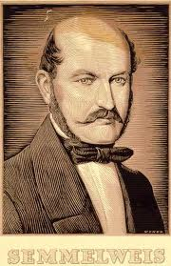
Brief History of Hand Hygiene
Ignaz Semmelweis
(1818 – 1865)
*enter link to Semmelweiss
video here
Notes:
Add link to blood and guts video

Slide 4
Brief History of Hand Hygiene
Mid 1800s – Semmelweiss first recognised link between HCW hands and transmission of infection
1980s - First National Hand Hygiene Guidelines
(CDC USA)
2000 – Geneva Multi Modal Culture Change Strategy
  Alcohol based handrub at point of care
  Talking walls
  Regular performance feedback to all HCW
  Sustained improvement in HH compliance and a reduction in HCAI
Notes:
Alcohol based hand hygiene programs have been shown to improve hand hygiene compliance and reduce HAIs in observational studies in Geneva and Melbourne.
The 1980s represented a landmark in the evolution of concepts of hand hygiene in health care. 1980s first national hh guidelines. 1995-1996 CDC/HICPAC recommended either soap and water or ABHR for hh after leaving rooms of patients with MDRO. 2002 HICPAC recommended ABHR as the standard of care for hh except in particular situations.

Slide 5
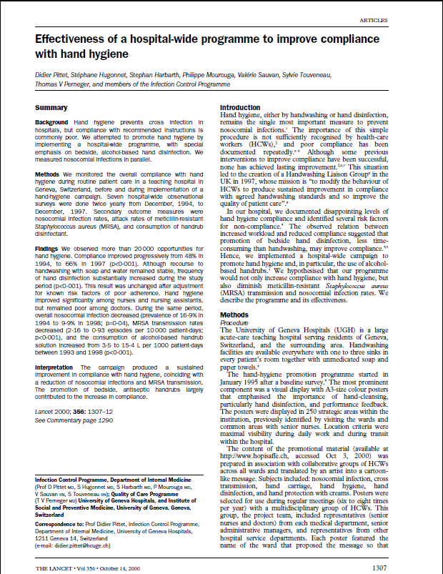
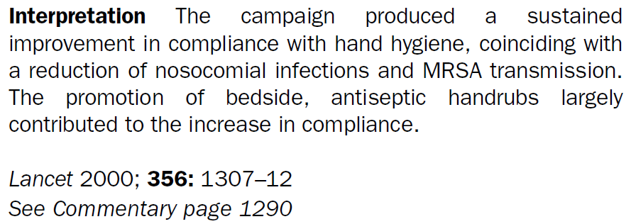
Notes:
This is the original paper produced by Didier Pittet et al on there HH program. Lindsay Grayson spend 6 months on sabbatical with Didder Pittet in Geneva and came back convinced this program could easily be adapted here to help over the issues that they were having at the Austin with MRSA in particular

Slide 6
WHO Multimodal Strategy
WHO – World Alliance for Patient Safety Campaign – ‘Clean Care is Safer Care’ launched in 2005
Released publication: WHO Guidelines on Hand Hygiene in Healthcare (2009)
  Recommend worldwide introduction of
  alcohol based healthcare worker hand hygiene program based on 5 Moments for Hand Hygiene

Slide 7
WHO Multimodal Strategy
System Change
  Alcohol based hand run at the point of care
Education and training
  When, why & how to perform hand hygiene
Monitoring and performance feedback
  Direct observation – 5 Moments
Reminders in the workplace
  Promotional materials
Institutional safety climate
  Embed hand hygiene in all activities

Slide 8
WHO Multimodal Strategy
Build
System Change
  Alcohol based hand run at the point of care
Education and training
  When, why & how to perform hand hygiene
Monitoring and performance feedback
  Direct observation – 5 Moments
Reminders in the workplace
  Promotional materials
Institutional safety climate
  Embed hand hygiene in all activities
Teach
Measure
Sell
Live

Slide 9
Brief History of Hand Hygiene
2001 - Austin Hospital - Operation Clean Start
  Based on Geneva model
  Signif. reduction in MRSA isolates, bacteraemias and ESBLs
2004 - Victorian Quality Council (VQC)
  Pilot project launched at 6 sites
  Followed by Phase 1 & 2 roll out across state
2007 - Hand Hygiene Victoria (HHV)
  All Vic acute Public facilities funded by DOH to participate
  Signif. improved HHC and reduced rates MRSA
2008 – Australian Commission on Safety and Quality in Healthcare (ACSQHC) instigated the National Hand Hygiene Initiative
Notes:
HH Baseline 20%, 53% at 12 months

Slide 10
Austin Hospital

Slide 11
Hand Hygiene Victoria

Slide 12
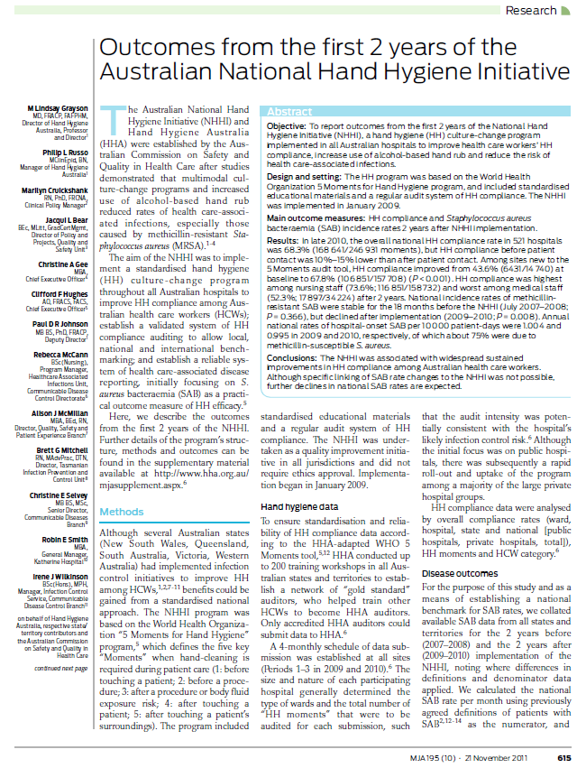
HHA 2 Year Results
MJA 2011

Slide 13
HHA 2yr Results
End 2010 521 hospitals were participating
National HHC rate 68.3%
(from 246 931 moments)
HHC 10 – 15% lower for M1
HHC highest with Nurses
HHC lowest with Medical staff

Slide 14
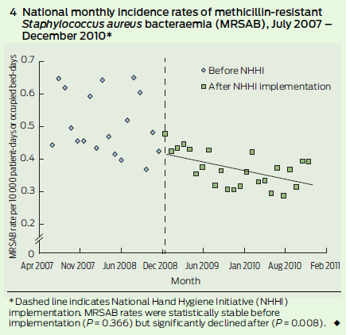
HHA 2yr Results
National incidence rate of MRSA bacteraemia was stable 18mths prior to the NHHI
Rate declined after implementation (P=0.008)

Slide 15
HH Program Challenges
Implementation
  Resources - Time
  Hospital support
Concerns about ABHR
Audit tool
  Familiarity
  Applicability to different clinical areas
Measurements
  What is an acceptable level of compliance?
  Should all hospitals aim for same level of compliance?
Notes:
With any program there will be challenges and this is no exception. Although hand hygiene sounds easy this is really a hard sell

Slide 16
Measuring Performance
Is 100% compliance achievable?
Hand Hygiene
Compliance 100%
100
Rate
Hospital Acquired
Infection rate 0%
0
Time
Notes:
It might be public perception that if you have 100% HHC then it results in a 0% HAI rate, however we all know that isn’t true
We know that HH is not the only issue that will give pts an infection.

Slide 17
Is 100% Compliance required?
Infection
rate
25
50
75
% Compliance
Notes:
But we do know that there is window of opportunity where you can have the most effect with this program

Slide 18

HHC and Infections
HHA have shown an association between improving HHC and reduction in infection rates
  Published in The Lancet ID Sept 2018

Slide 19
The Lancet
Effects of the Australian National Hand Hygiene Initiative after 8 years on infection control practices, health-care worker education, and clinical outcomes: a longitudinal study
  For every 10% increase in hand hygiene compliance, the incidence of HA-SAB decreased by 15%

Slide 20
Workshop Objectives
Introduce HHA resources
To understand HHA 5 Moments
To learn how to use HHA 5 Moments audit tool
To learn how to enter HH compliance data
To become a Gold Standard Auditor
  Train others to be auditors in your facility

Slide 21
Partnering to Heal
Partnering to Heal is a computer-based, video-simulation training program on infection control practices for clinicians, health professional students, and patient advocates.
The training highlights effective communication about infection control practices and ideas for creating a "culture of safety" in healthcare institutions to keep patients from getting sicker.

Slide 22
Partnering to Heal
http://health.gov/hcq/trainings/partnering-to-heal/index.html (web)
*Link to Partnering to heal video file
Office of Disease Prevention and Health Promotion, USA

